Slide 1


Joint session of IN2P3 and IRFU Scientific Councils
Neutrinoless double beta decay: focus on CUPID
October 6, 2025, CNRS headquarters, Paris
.
Marcella Grasso
Scientific Director
Nuclear and Hadronic Physics
CNRS, IN2P3
Nathalie Besson
Head of
Particle Physics Department
CEA IRFU

Slide 2
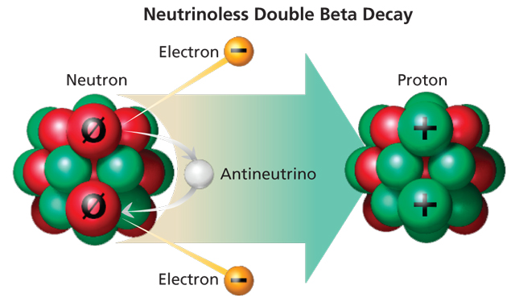
Why do scientists try to observe this rare and hypothetical nuclear decay?
Several scientific domains are involved and may be impacted
COSMOLOGY:
matter/antimatter asymmetry
If lepton number is not conserved ->
there may be an impact on matter/antimatter asymmetry
NEUTRINO PHYSICS:
the nature of neutrinos:
If this decay is observed ->
neutrinos are Majorana particles
PARTICLE PHYSICS:
new physics beyond the Standard Model
If this decay is observed ->
the total lepton number is not conserved
NUCLEAR PHYSICS:
to compute half-lives, nuclear matrix elements are necessary (theoretical nuclear approaches for the predictions).
If this decay is observed ->
test for models and the nuclear interaction (benchmark for example for ab-initio models)
High-impact science is expected!

Slide 3
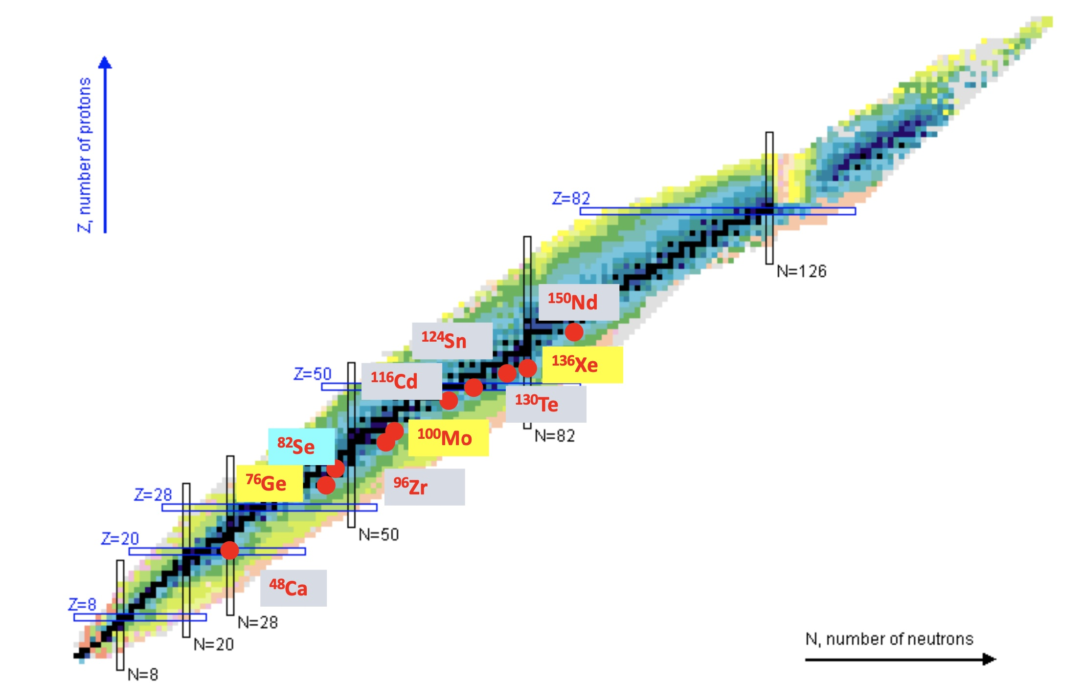
Neutrinoless double beta decay is included
in the IN2P3 Nuclear and Hadronic Physics portfolio since 2024
IN2P3 presently aims to define a scientific strategy with structured activities, focused on an existing new-generation project, within an international collaboration. Different techniques are employed in these projects with, mainly, a focus on 3 isotopes: Ge (LEGEND), Mo (CUPID), Xe (nEXO)
Status at IN2P3 on Neutrinoless Double Beta Decay: about 20 scientists (plus theorists for the calculation on nuclear matrix elements), 14 FTE (engineers and technicians)
Morning session (only IN2P3)
SuperNEMO demonstrator: data taking started in Spring 2025. Dismantling planned in January 2027
R&D activities (R2D2)
Afternoon session (IRFU and IN2P3)
CUPID (strong collaborations with CEA), based on scintillating bolometers

Slide 4
At CNRS-IN2P3
A few main recent steps for IN2P3 scientists and engineers involved in CUPID
2020
The experiment CUPID-Mo, located at LSM in Modane, demonstrated an excellent potential for the detection of 0νββ with about 2,3 kg of ¹⁰⁰Mo, after 1 year data taking. This validated the choice of the isotope and of the bolometric detector containing it (Li₂MoO₄cristals)
2023
The IJCLab Orsay technology for light detectors based on the Neganov-Trofimov-Luke effect (to improve the signal-to-noise ratio) was chosen by the collaboration
2025
Andrea Giuliani, IJCLab Orsay, is elected international spokesperson of the CUPID collaboration

Slide 5
CUPID funding for IN2P3 teams (IN2P3 funding started in 2021. Total: more than 4 M investment in the last 13 years for IN2P3 teams)
2010
2015
2020
2025
2030
Investment: 260 k€ (IJCLab, IP2I)
IN2P3
Development of the Li2MoO4 scintillating bolometer technology (CSNSM, CEA, IAS, ICMCB)
ANR LUMINEU
Investment: 820 k€ (220 k€ for CSNSM)
Purification and crystallization of Li2MoO4 technology
(CSNSM, SiMaP, ILM, ICMCB)
ANR CLYMENE
Opération (au moins 3 décennies)
Investment: 580 k€ (130 k€ for CSNSM)
ERC AdG CROSS
Li2MoO4 and TeO2 detectors with advanced
technologies in Canfranc underground facility
(IJCLab)
Investment: 2.2 M€
P2IO Labex flagship project on neutrino physics
(IJCLab, CEA/IRFU, CEA/IPhT, LLR)
ANR P2IO BSM-nu
Investment for DBD: 270 k€ (90 k€ for IJCLab)
ANR CUPID-1
CUPID first tower assembly and
light detector facilities
(IJCLab, LPSC, IP2I, CEA)
Investment : 580 k€ (370 k€ for IN2P3 labs)
Evaporation chamber to fabricate CUPID light detectors
funded by the region Ile-de-France (IJCLab, CEA)
CRYOVAP (REGION)
Investment : 600 k€
Development of light detectors for CUPID and R&D for CUPID-1T (IJCLab)
Opération
ANR CRYOLUX
Investment : 360 k€

Slide 6
Neutrino physics at IRFU
 | Nν | Mixing param. | Mass ordering | Masses | Nature | ν properties
Oscillation exp. | ✓ | ✓ | ✓ |  |  | ✓
β decay exp. | ✓ |  | ✓ | ✓
2β decay searches |  |  | ✓ | ✓ | ✓
Coherent scattering |  |  |  |  |  | ✓
Cosmology | ✓ |  |  | ✓
Neutrinos raise many fundamental questions
& there's a wealth of tools available:
Comparison and combination of data from various
experiments are crucial for precise neutrino measurements
and a comprehensive understanding of their properties.
IRFU capitalizes on three key strengths:
An important historical involvement in neutrino oscillation experiments
Expertise in nuclear processes, neutrino fluxes measurements, neutrino interactions, neutrino production processes
Expertise in the development of low background detectors for neutrinoless double beta decay experiments
Cosmology: BOSS, eBOSS, DESI
Neutrino physics: 23 FTE + 9 postdoctoral fellows and PhD students. At DPhP +7 in the last 5 years including 4 new hiring
DBD experiments = only access to neutrino nature

Slide 7





A focus on neutrinoless double beta decay
At IRFU, neutrinoless double beta searches follows the technology ligneage of rare event searches with bolometers, with expertise on:
Conception and assembly of detectors
Cryogenics and vacuum techniques
Low radioactivity
Underground Labs
(Cold) Low noise electronics
Data analysis
Simulations
From 1 FTE and 1 PhD student in 2012-215
to 8,5 FTE, 2 PhD students and 2 postdoctoral fellows in 2025
3 PhD obtained
Total of 6 M€
Hardware only

Slide 8



Neutrinoless double beta decay projects
2017-2023
Selection of ¹⁰⁰Mo for CUPID
2020-2026
ERC grant
Open the way to normal hierarchy
01
LUMINEU
02
CUPID-Mo
03
CUPID
04
BINGO
05
TINY
2012-2016
Selection of Li₂MoO₄ for a pilot experiment
2016 - …
Next generation experiment
2023-2028
ERC grant
Two new isotopes under study
World limit on ¹⁰⁰Mo and technology chosen for CUPID
New cryo-platform at IRFU for above-ground test
New low radioactivity cryo-platform at LSM
Strong collaboration with IN2P3 throughout all the projects

Slide 9
Context
The international context for future new-generation neutrinoless double beta decay projects has evolved over the last years
International collaborations have mainly focused on a few projects. The three main new-generation projects, based on different technologies and aiming to use different isotopes are: LEGEND (ton-scale, ⁷⁶Ge), nEXO (ton-scale, ¹³⁶Xe), CUPID (240 kg, ¹⁰⁰Mo)
At the end of 2024, DOE informed the community of the decision to withdraw from the commitment to nEXO and to concentrate the support only on one ton-scale project, LEGEND
In France, CNRS and CEA scientists and engineers are involved in CUPID since several years

Slide 10
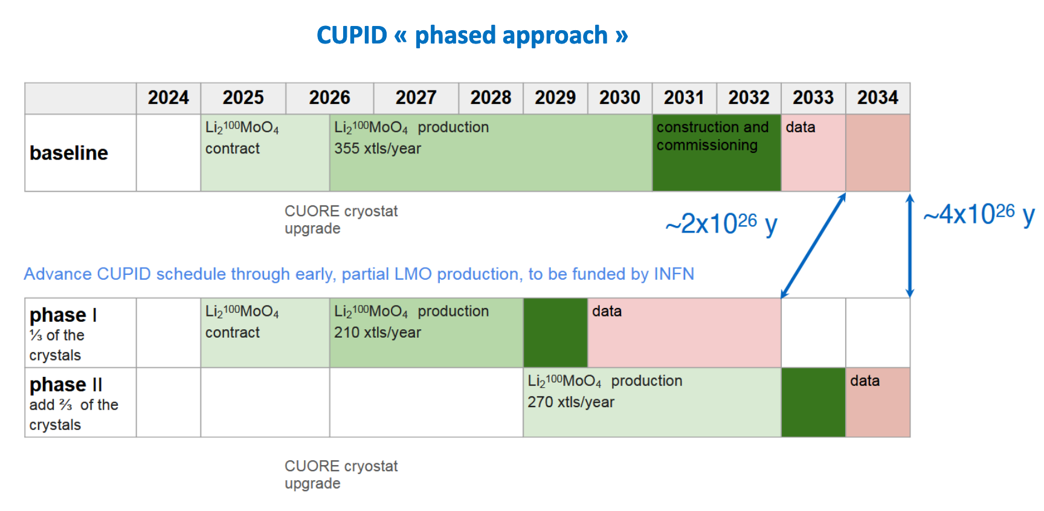
What is planned
A phased approach
A first draft of a Memorandum of Understanding for CUPID including INFN, CEA and IN2P3 is under discussion for the phase 1

Slide 11
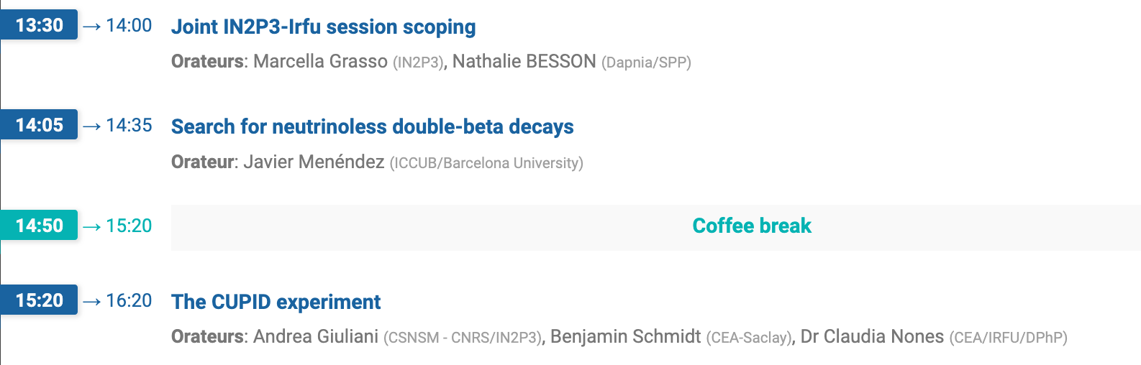
Agenda

Slide 12
IN2P3 and IRFU suggest the following points to be addressed:
What is the competitivity of the phase 1 of CUPID in the international landscape, compared to other existing projects (expected sensibility and potential scientific impact)?
What are the main specificities of the French contributions, within the CUPID collaboration? What is the scientific and instrumental weight of our teams in the collaboration ?
Manpower and financial aspects: what would be necessary for our teams to achieve the objectives of phase 1 within the timeframe? How the present involvement and financial support should be expected to evolve in next years to ensure strong scientific outcomes?
What is the competitivity of the phase 2 of CUPID, in terms of calendar and expected scientific outcomes, compared to the other projects? In case a further French implication in the phase 2 would be decided in the coming years (if funding sources are identified) what could be the contributions to the project of our teams?

Slide 13
Thank you for your attention

