Slide 1
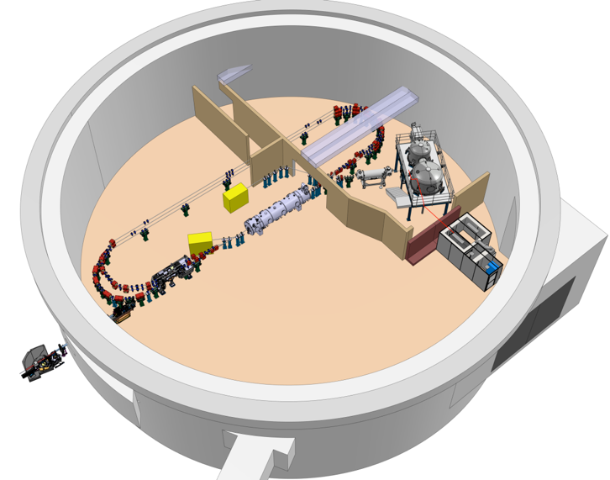
September 24-27, 2024 KEK, Tsukuba, Japan
PERLE Potential Applications
Walid Kaabi
IJCLab / Université Paris-Saclay/ IN2P3-CNRS
On behalf of PERLE Collaboration

Slide 2
Introduction:
PERLE: Powerful Energy Recovery Linac for Experiments
PERLE: Powerful Energy Recovery Linac for Experiments
PERLE: Powerful Energy Recovery Linac for Experiments
Demonstration of multi-turn and high current operation:
Careful attention to machine design (Lattice, beam dynamics and collective effects, filling pattern, BBU…)
Good control of the beams (shape, position, synchronisation, losses…)
Validation of ambitious technical choices:
High-charge electron gun: 500 pC at 40 MHz
Optimized 800 MHz SRF system designed to maximize efficiency
Switchyards and common circulation arcs for accelerated and decelerated beams
Non-invasive diagnostics
…
Experiments compatible with ERL functioning
No/small impact on beam after interaction
No important changes in beam path length during implementation
Of interest for the lab/institute team/community.
Special beam requirements:
Injector and lattice flexibility: charge, emittance, bunch length, dispersion…
Need of dedicated optics/diagnostics in IP region
Impact on machine footprint
Equipment/spectrometer/detector in IP region or elsewhere, additional shielding/cooling…

Slide 3
Introduction:
Foremost, PERLE is an ERL demonstrator:
Its construction, commissioning, debugging and tuning up to the optimal parameters will require time.
Further accelerator developments should still possible and time should be allocate for it (implementation of new technology enhancing PERLE efficiency, new diagnostics…).
But, to fund the machine construction, cover its running cost and then ensure its longevity, we could not relay only on the demonstrator argument. Applications are always required by funding agencies, mostly on R&D fields or societal applications.
A trade off between a demonstration machine and a users facility was found
It is foreseen that PERLE will host 2 R&D set-up for :
Inverse Campton scattering source (ICS)
Electron scattering on online produced Radioactive ion experiment.
The emplacement of the two experiments have to be anticipated in the design phase to avoid unwanted modification of the path length during implementation, the cross talk between magnetic elements at crowded regions…

Slide 4
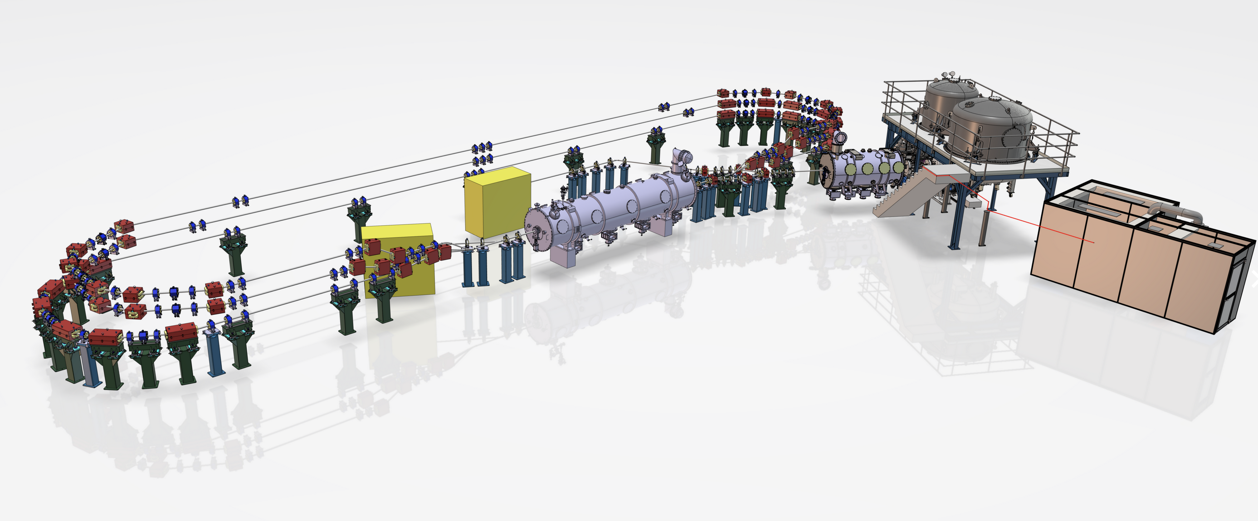
Interaction Points locations and constrains
Fixed location of the DC Gun
Available straight line to host 2 IP
Available straight line to host 1 IP
The only possible location for FP cavity
location of an existing X-hutch
PERLE 250 MeV version

Slide 5
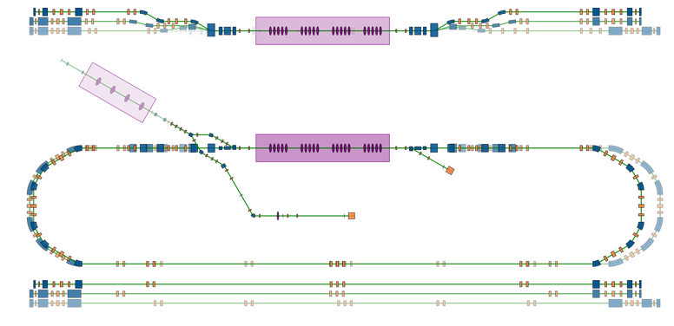
Interaction Points locations and constrains
PERLE 250 MeV version
89 MeV
171 MeV
253 MeV
2.3m
2.3m
Not enough for focusing & FP cavity: 0.9m + 2m
Booster
Merger
Cryomodule
IP1 (FP)
7 MeV
Diag. Line
7 MeV
IP2

Slide 6
Interaction Points locations and constrains
PERLE 250 MeV version
0.5m
-0.1m
-0.4m
89 MeV
171 MeV
253 MeV
1m
1.3m
1m
3.3m
Booster
Merger
Cryomodule
IP1 (FP)
7 MeV
Diag. Line
7 MeV
IP2

Slide 7
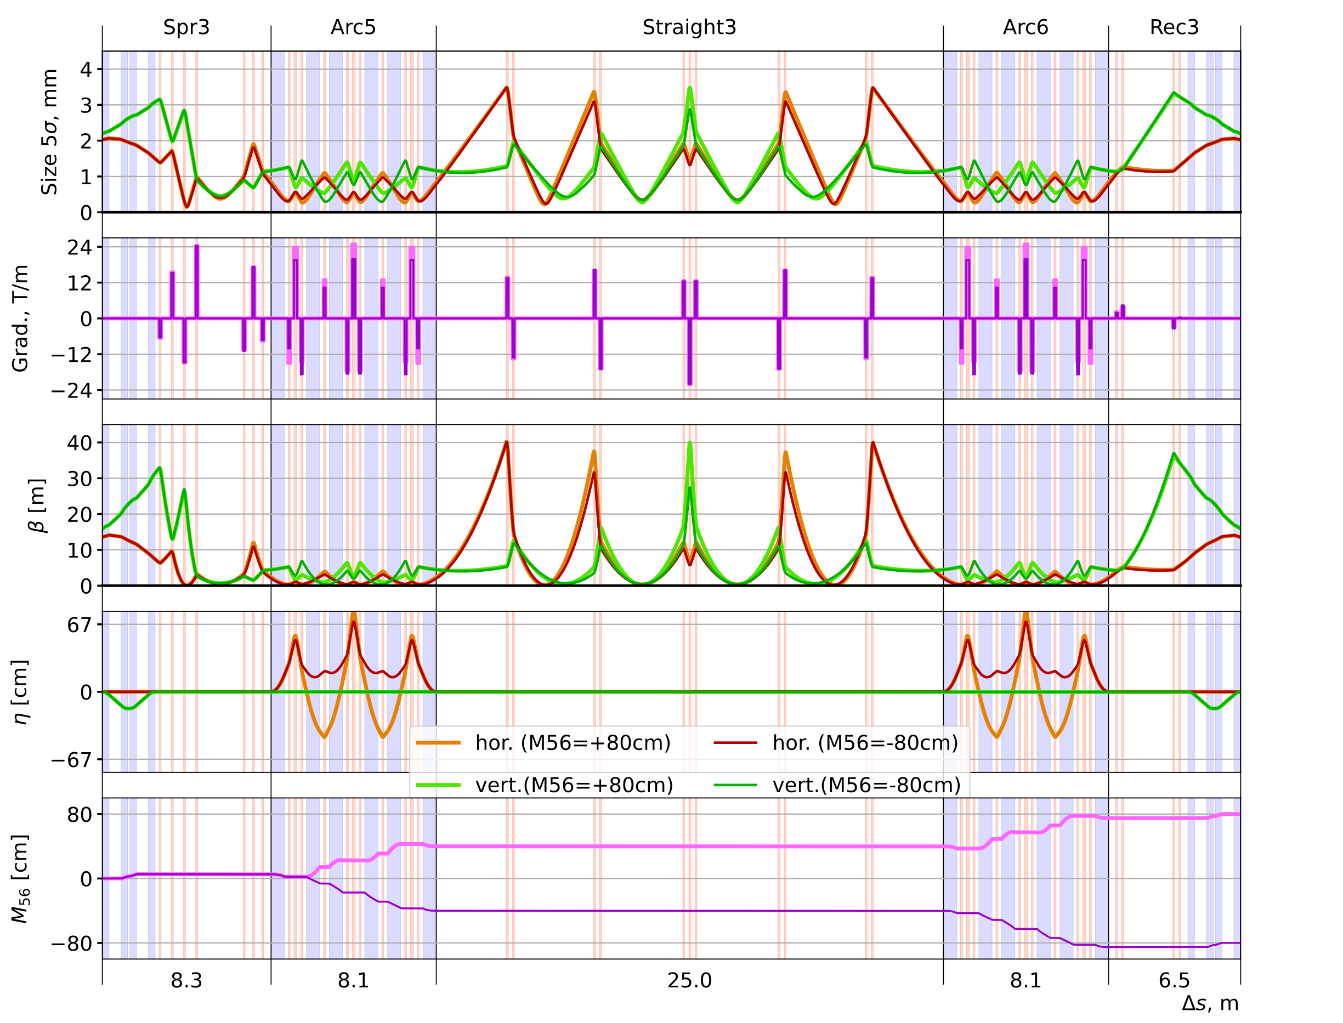
Interaction Points locations and constrains
Optics of the 3rd Turn (updated)
Spreader and Recombiner are not symmetric
Quadruples is Arcs close the dispersion and compensate M56 of Spreader and Recombiner
Low beta (β=30cm) regions for experiments
IR1: Fabry Perot (2m) in the Spreader section
IR2: scattering on unstable ions (in the straight section)
Beam size (5σ) under 4 mm
Maximal gradient of quadruple magnets < 24 T/M
Tuning M56 in the Arcs
Possible to gain M56 = ±80 cm with minor change of beam properties or introduce a local bump of M56 = ±40 cm (probably more — ongoing studies)
IR1
IR2

Slide 8
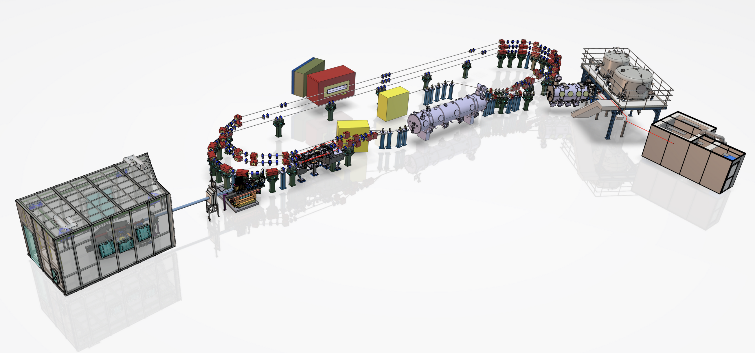
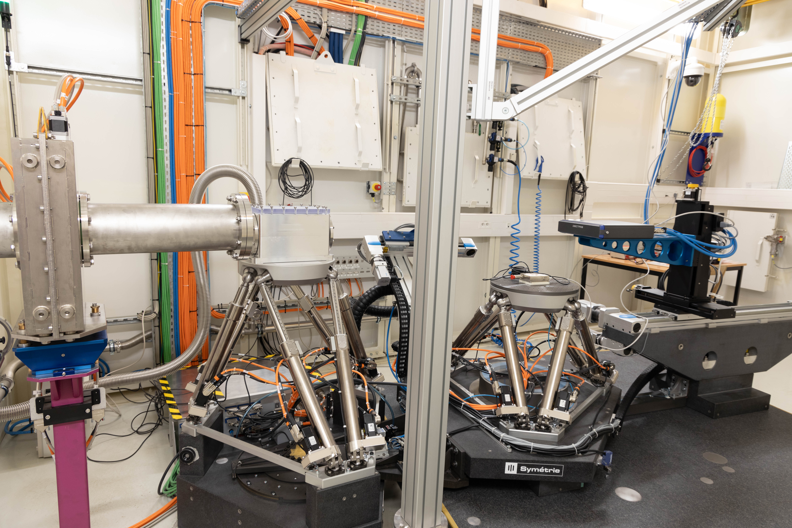
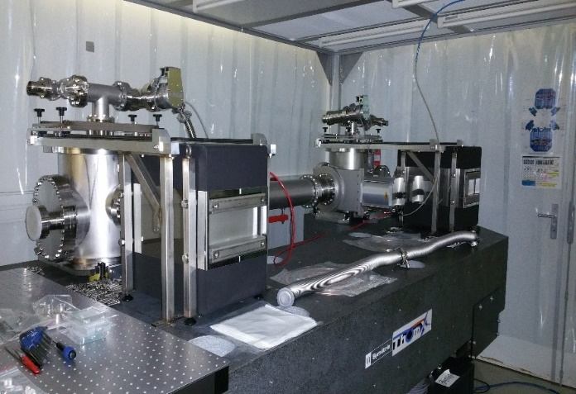
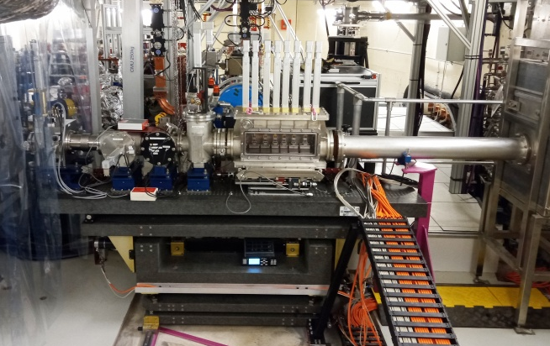
Inverse Campton scattering source @ PERLE
X-LINE in X-HUTCH
Fabry-Perot Cavity
X-LINE elements inside bunker

Slide 9
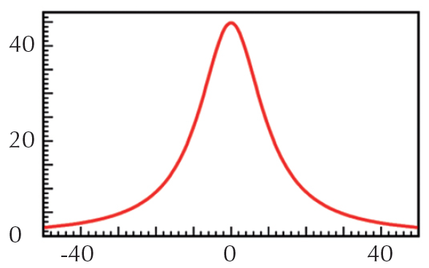
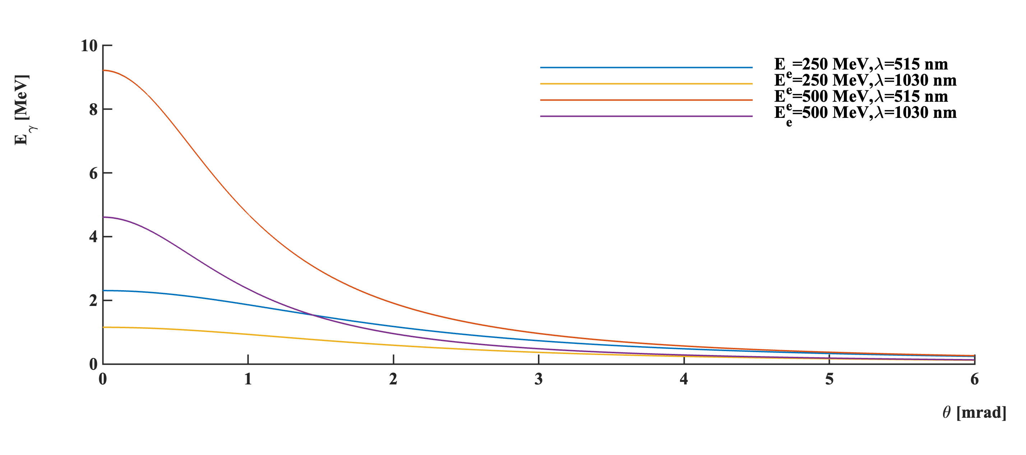
X-ray Compton sources: HOW ?
Courtesy to Marie Jacquet
Power LASER pulses
For ThomX: 50 MeV e⁻ beam
1030 nm laser
ELECTRON bunches
(few tens of MeV)
θ ~ 10 mrad → 22 keV
θ
on-axis photons → 45 keV
X-RAYS
(few tens of keV)
Conical X beam, Naturally divergent
Univocal relation between the energy E_{X} and the diffusion angle θ
--> Quasi-Monochromatic beam with a simple diaphragm. Price to pay → Flux reduction
E_{X} (KeV)
laser (E_{λ}=hc/𝜆=1.2eV)
θ (mrad)
α
Compton photon:
$E_{X/γ}≃{\frac{4γ^{2}\left(1−\frac{α^{2}}{4}\right)}{1+γ^{2}θ^{2}}E}_{λ}≈1.4 MeV$
θ
e⁻ beam: $Ee=250 MeV$
𝜆 Laser = 1030 nm

Slide 10
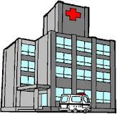
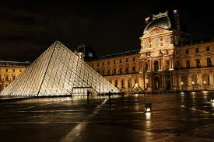
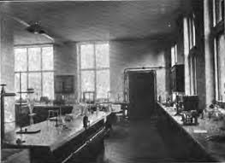
High flux, high brightness: How?
Nb. of
particles/BUNCH
Electron
LORENTZ factor
FEL
N_{e} × N_{γ} × F_{rep}
Flux × $γ^{2}$
Flux ~
Bright ~
$σ_{e}^{2}$ + ${ σ}_{γ}^{2}$
$$ε_{N}^{2}$$
Synchrotrons
TRANSVERSE
beam SIZES
Repetition
FREQUENCY
Electron
EMITTANCE
Brightness (ph/s/mrad²/mm²/0.1% bw)
ICS
projects
Some powerful analyzes currently realized at synchrotrons and requiring a high brightness beam could be developed in a lab-size environment (hospitals, labs, museums).
X-ray tubes
X-ray energy (keV)
Avg. Flux ~ 10⁹ - 10¹⁴ ph/s Many projects in the last 15 years
Hard X-ray

Slide 11
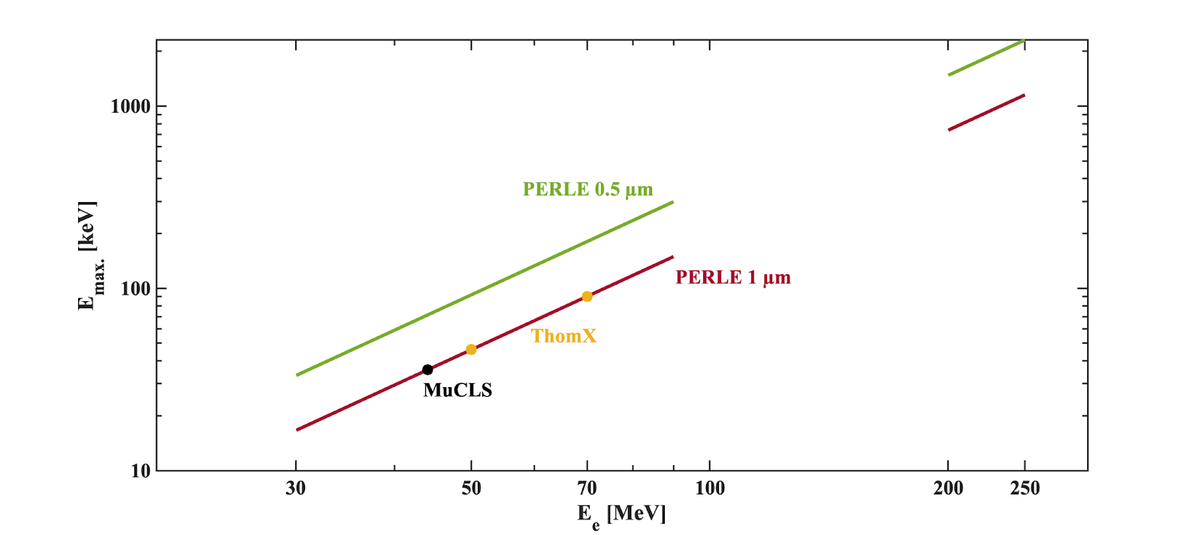
Potentiality of an ICS on PERLE:
With PERLE 1 turn: 89 MeV → expected X-ray energy in the range of 100-300 keV (depending on used laser: Infra-red or green):
Most interesting applications areas are in this rage of X-ray Energy:
Cultural heritage field (imaging small statues, metallic relics),
Palaeontology (large 10-20 cm thick fossils, skulls, bones, etc. from dinosaurs, mammut and hominids),
Natural history (bones of large mammals as whales, but also horses etc.)
monitoring rhinestones and fatigue of steel structures such as the hulls of merchant ships
new field of investigation in radiotherapy applications. Examples include microbeam radiation therapy (MRT) or metal nanoparticle-based radiotherapy. A compact source with appropriate beam parameters provides a pathway to translating such applications into a clinical setting.
Courtesy to Aurélien Martens
Figure 1: Maximum energy of photons produced with Compton backscattering X-ray sources as function of the electron beam energy. Different existing machines are indicated with points: MuCLS (black), ThomX at 50 and 70 MeV electron beam (orange). Thanks to the tunability of the electron beam in the PERLE accelerator, PERLE@1turn and PERLE@3turns are indicated with red and green lines for its use with an infrared or green laser

Slide 12
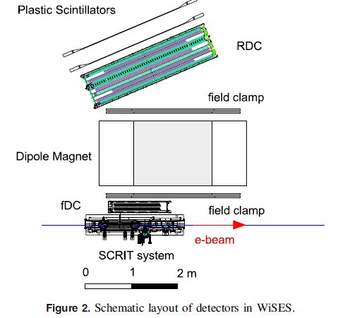
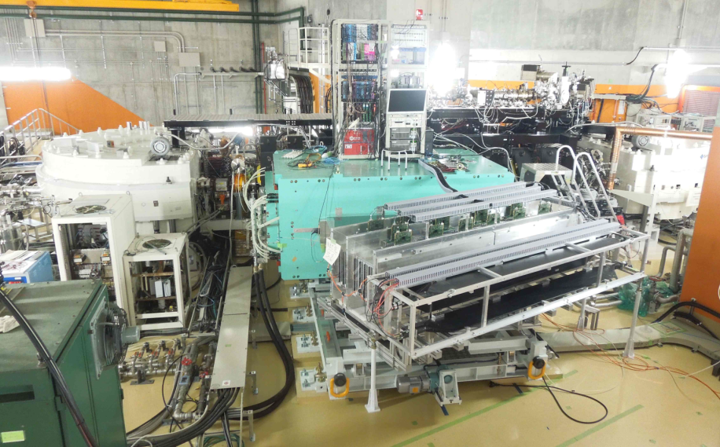
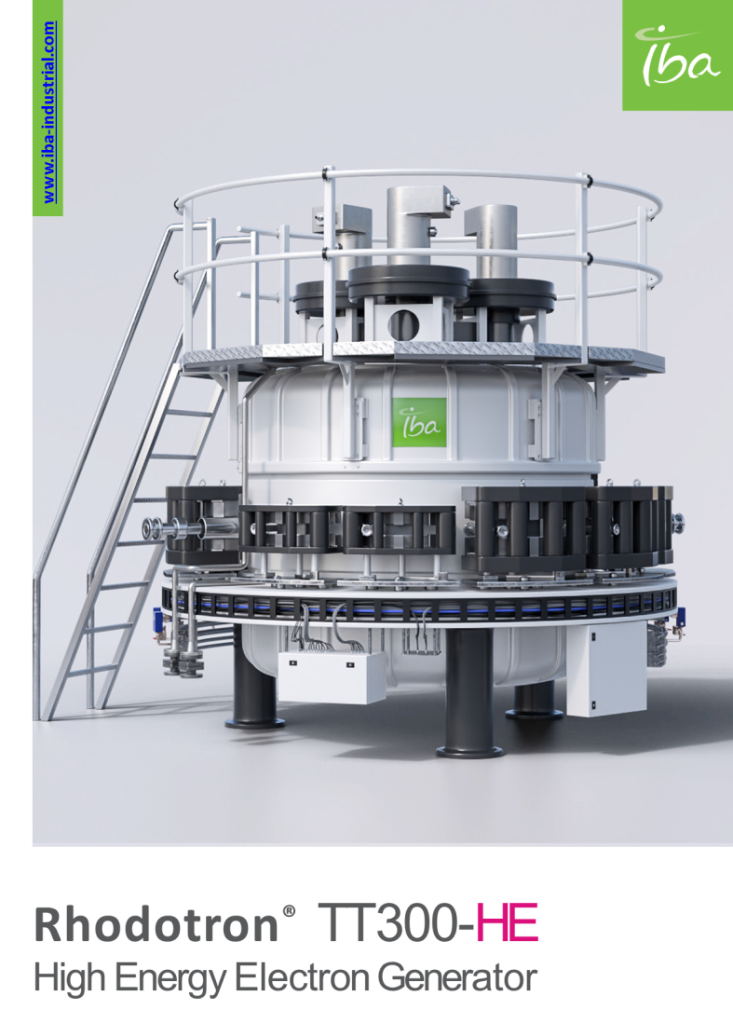
Elastic Scattering off radioactive Nuclei:
DESTIN @ PERLE (Deep Structure Investigation of exotic Nuclei):
Perspectives for the study of form factors of exotic nuclei with PERLE with fixed
target strategy : more compact, less resource demanding
This physics project at PERLE requires 3 major ingredients:
a Radioactive Ion Beam (RIB) factory:
1st option: acquire a Rhodotron (1)
2nd option: build a photofission facility (e- beam 50 MeV 100uA).
a Radioactive target preparation device (2): to be developed.
an electron spectrometer (3)
Courtesy to David Verney
Rear drift chamber
0.4 T for 150 MeV
Front drift chamber
(3)
(1)
T Ohnishi et al Phys. Scr. T166 (2015) 014071

Slide 13
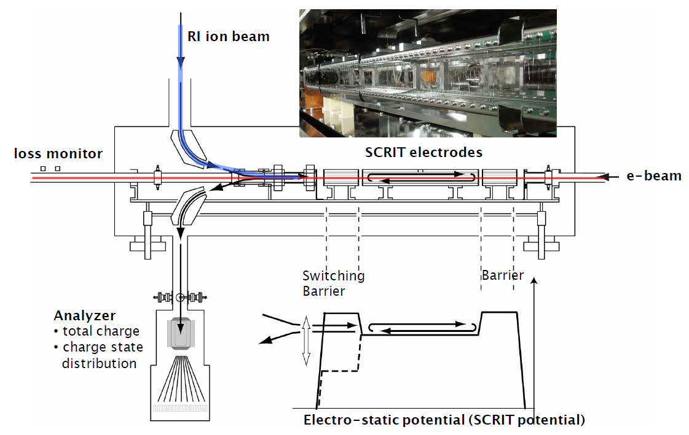
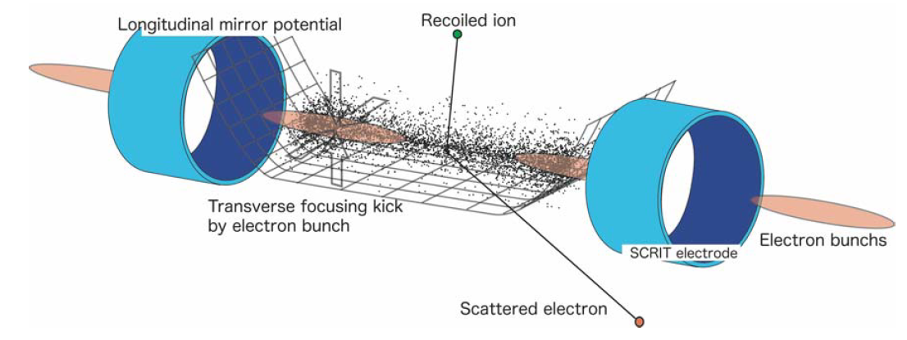
Elastic Scattering off radioactive Nuclei:
The radioactive target preparation device
all the complexity is concentrated in the target formation,
target characteristics will define the achievable luminosities
(2)
the radioactive target is a cloud of radioactive ions captured by the electrostatic potential created by the electron beam + auxiliary electrodes

Slide 14
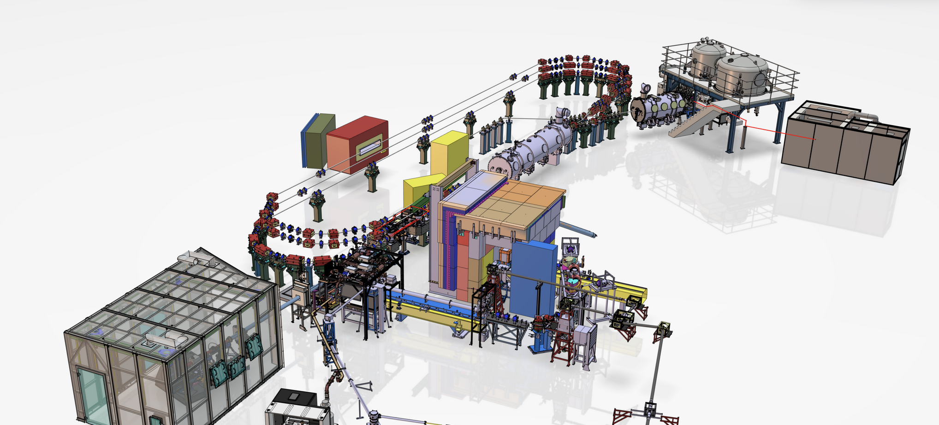
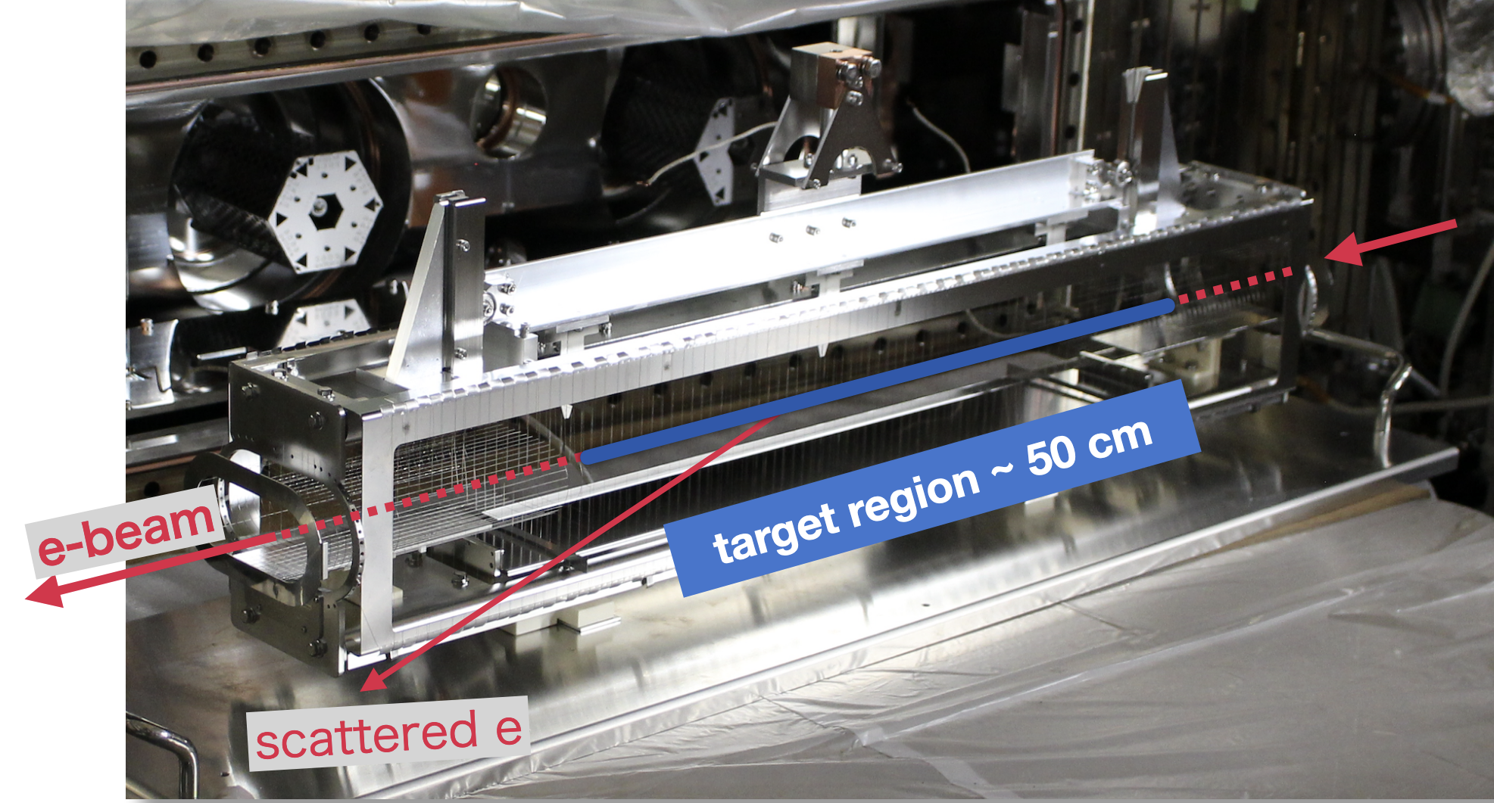
Implementation of DESTIN @ PERLE:
Spectrometer
Ion target location
RIB factory
50 MeV e- Linac

Slide 15
Potentiality of an DESTIN @ PERLE:
past experiments on stable nuclei
beam :
I_{e}=25 µA
E_{e}= 449.5 MeV; “energy spread” ΔE=0.5 MeV
target :
0.5 mm thick !
400 mg/cm² equiv. 4.1×10²¹ atoms/cm²
luminosities upto : $ℒ≃{10}^{32 }$cm⁻²s⁻¹
future fixed-target RI experiments
beam :
I_{e}=20 mA (PERLE nominal)
target :
a cloud of ions !
exact amount ? 10¹⁰⁻¹¹ atoms/cm²
3 orders of magnitude
more
10 to 11 orders of magnitude less
luminosity difficult to evaluate exactly
(the size of the e beam is far from being the only driving parameter ! )
The ball is also in the court of nuclear physics : design and optimization of the “target”, need to invent new trapping strategies.
A serious evaluation of the achievable luminosities can only be obtained thanks to more elaborate simulations:
(eg charge state evolutions).
A demonstrator is mandatory

Slide 16
Thank you for your attention

Slide 17
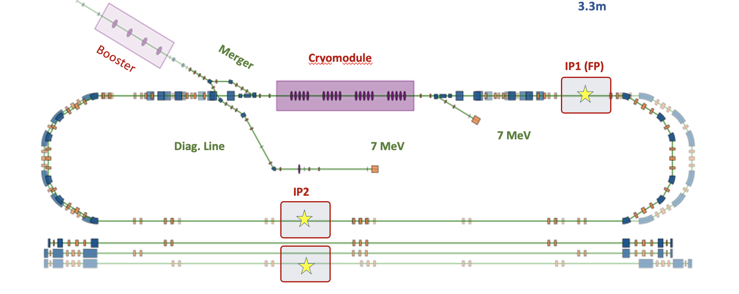
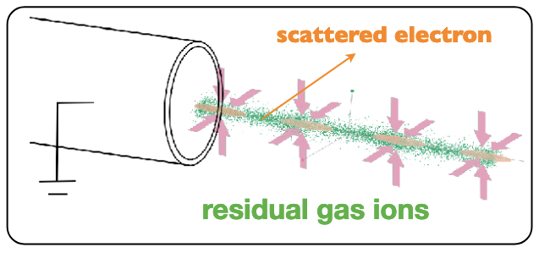
Summary slide for applications on PERLE
We are considering hosting 2 R&D set-up at PERLE:
An inverse Campton scattering source (ICS) at IP1
An electron scattering on online produced radioactive ion experiment at IP2.
ELECTRON bunches
(few tens of MeV)
θ ~ 10 mrad
θ
on-axis photons: most energetic
X-RAYS
(few tens of keV)
Low beta (β=30cm) at regions for experiments

Slide 18
Ions trap
Spectrometer for e- scattering
X-LINE in X-HUTCH
Fabry-Perot Cavity
X-LINE elements inside bunker

