Slide 1
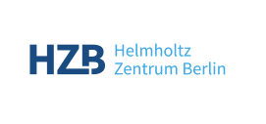

42nd International Conference on High Energy Physics
PERLE & bERLinPro: Two key accelerator projects as pathfinders for future ERL based HEP colliders
Walid Kaabi (IJCLab-CNRS)
On behalf of PERLE Collaboration
Axel Neumann (HZB)
For the bERLinPro team @ SEALAB

Slide 2
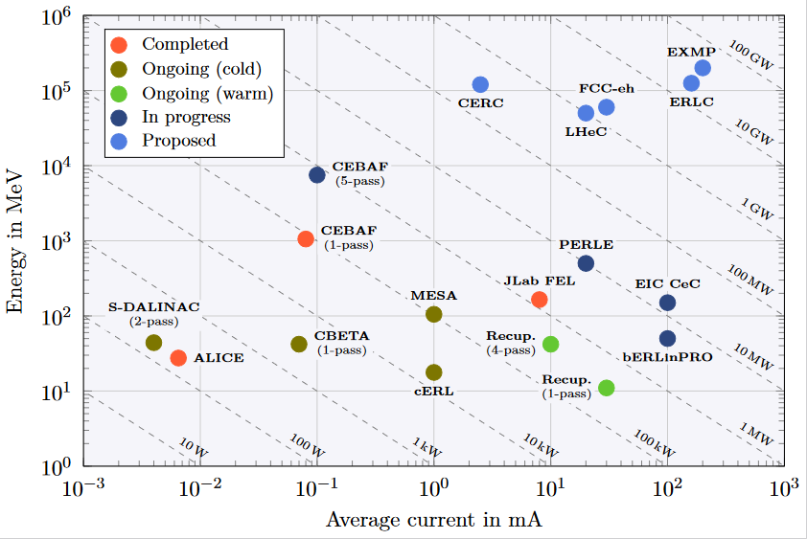
ERL - The global landscape
Funding Limited
Technology Limited

Slide 3
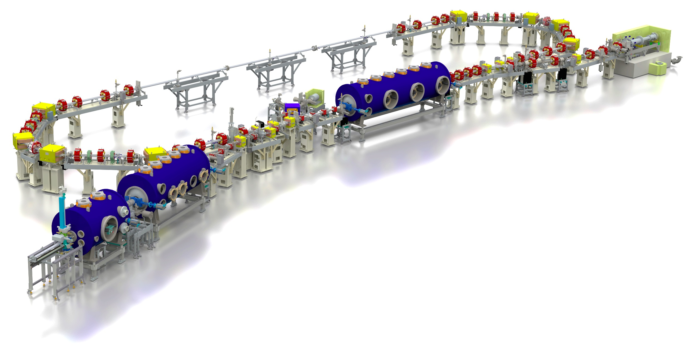
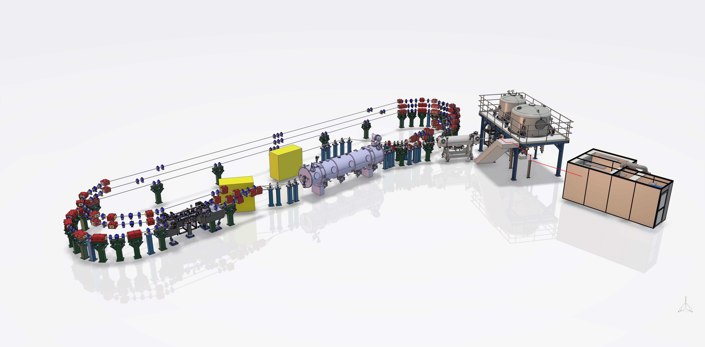
bERLinPro and PERLE layout
beam dump
6.5 MeV, 100 mA
= 650 kW
linac module
3 x 7 cell SRF cavities @1.3 GHz
44 MeV
merger
dogleg
Booster
3 x 2-cell SRF cavities @1.3 GHz
4.5 MeV
DC-gun
350 keV, 500 pc @ 40MHz
SRF-gun
1.4 cell SRF cavities
1.5-2.3 MeV, single SC solenoid,
Beam dump
7 MeV, 20 mA
= 140 kW
Laser room
Merger
Booster
4 single cell SRF cavity @800 MHz, 7 MeV
Linac module
4 x 5-cell SRF cavity @800 MHz, 82 MeV
3 stacked isochronous circulation arcs
for 3 different energy beams
PERLE 250 MeV version

Slide 4
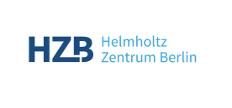
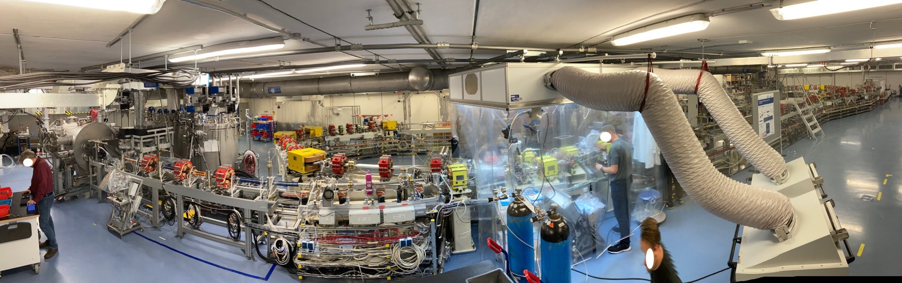
Stages at bERLinPro
Presently installed facility
CW photoinjector studies < 10 mA
Long-pulse injector studies < 100 mA
Installed: 10-mA SRF gun + merger + recirculation + dump
Installed: Proof-of-principle UED experiment
Funded: Booster module. Produced but assembly required
Not funded: LINAC module
Not funded: 100-mA class photoinjector
High-power beam studies (“long pulse”)
High-power energy recovery
Energy-efficient RF operation

Slide 5
Stages at bERLinPro
Presently installed facility
Applications
Short pulse, low emittance
Low charge
UED Exp.
High power beam
Waste Water
Make use of injector’s flexibility for beam parameter range
→ Cover in parallel ERL relevant beam studies
Installed: 10-mA SRF gun + merger + recirculation + dump
Installed: Proof-of-principle UED experiment
Planned: Waste water treatment demonstrator
Funded: Booster module. Produced but assembly required
Not funded: LINAC module
Not funded: 100-mA class photoinjector
CW photoinjector studies < 10 mA
Long-pulse injector studies < 100 mA
High-power beam studies (“long pulse”)
High-power energy recovery
Energy-efficient RF operation

Slide 6
Stages at bERLinPro
Presently installed facility
Applications
UED Exp.
Waste Water
Installed: 10-mA SRF gun + merger + recirculation + dump
Installed: Proof-of-principle UED experiment
Planned: Waste water treatment demonstrator
Funded: Booster module. Produced but assembly required
Not funded: LINAC module
Not funded: 100-mA class photoinjector
CW photoinjector studies < 10 mA
Long-pulse injector studies < 100 mA
High-power beam studies (“long pulse”)
High-power energy recovery
Energy-efficient RF operation

Slide 7
Stages at bERLinPro
Presently installed facility
Applications
UED Exp.
Waste Water
Installed: 10-mA SRF gun + merger + recirculation + dump
Installed: Proof-of-principle UED experiment
Planned: Waste water treatment demonstrator
Funded: Booster module. Produced but assembly required
Not funded: LINAC module
Not funded: 100-mA class photoinjector
CW photoinjector studies < 10 mA
Long-pulse injector studies < 100 mA
High-power beam studies (“long pulse”)
High-power energy recovery
Energy-efficient RF operation

Slide 8
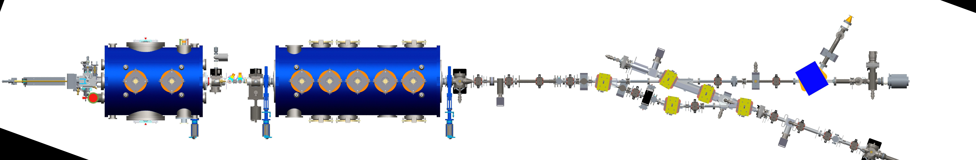
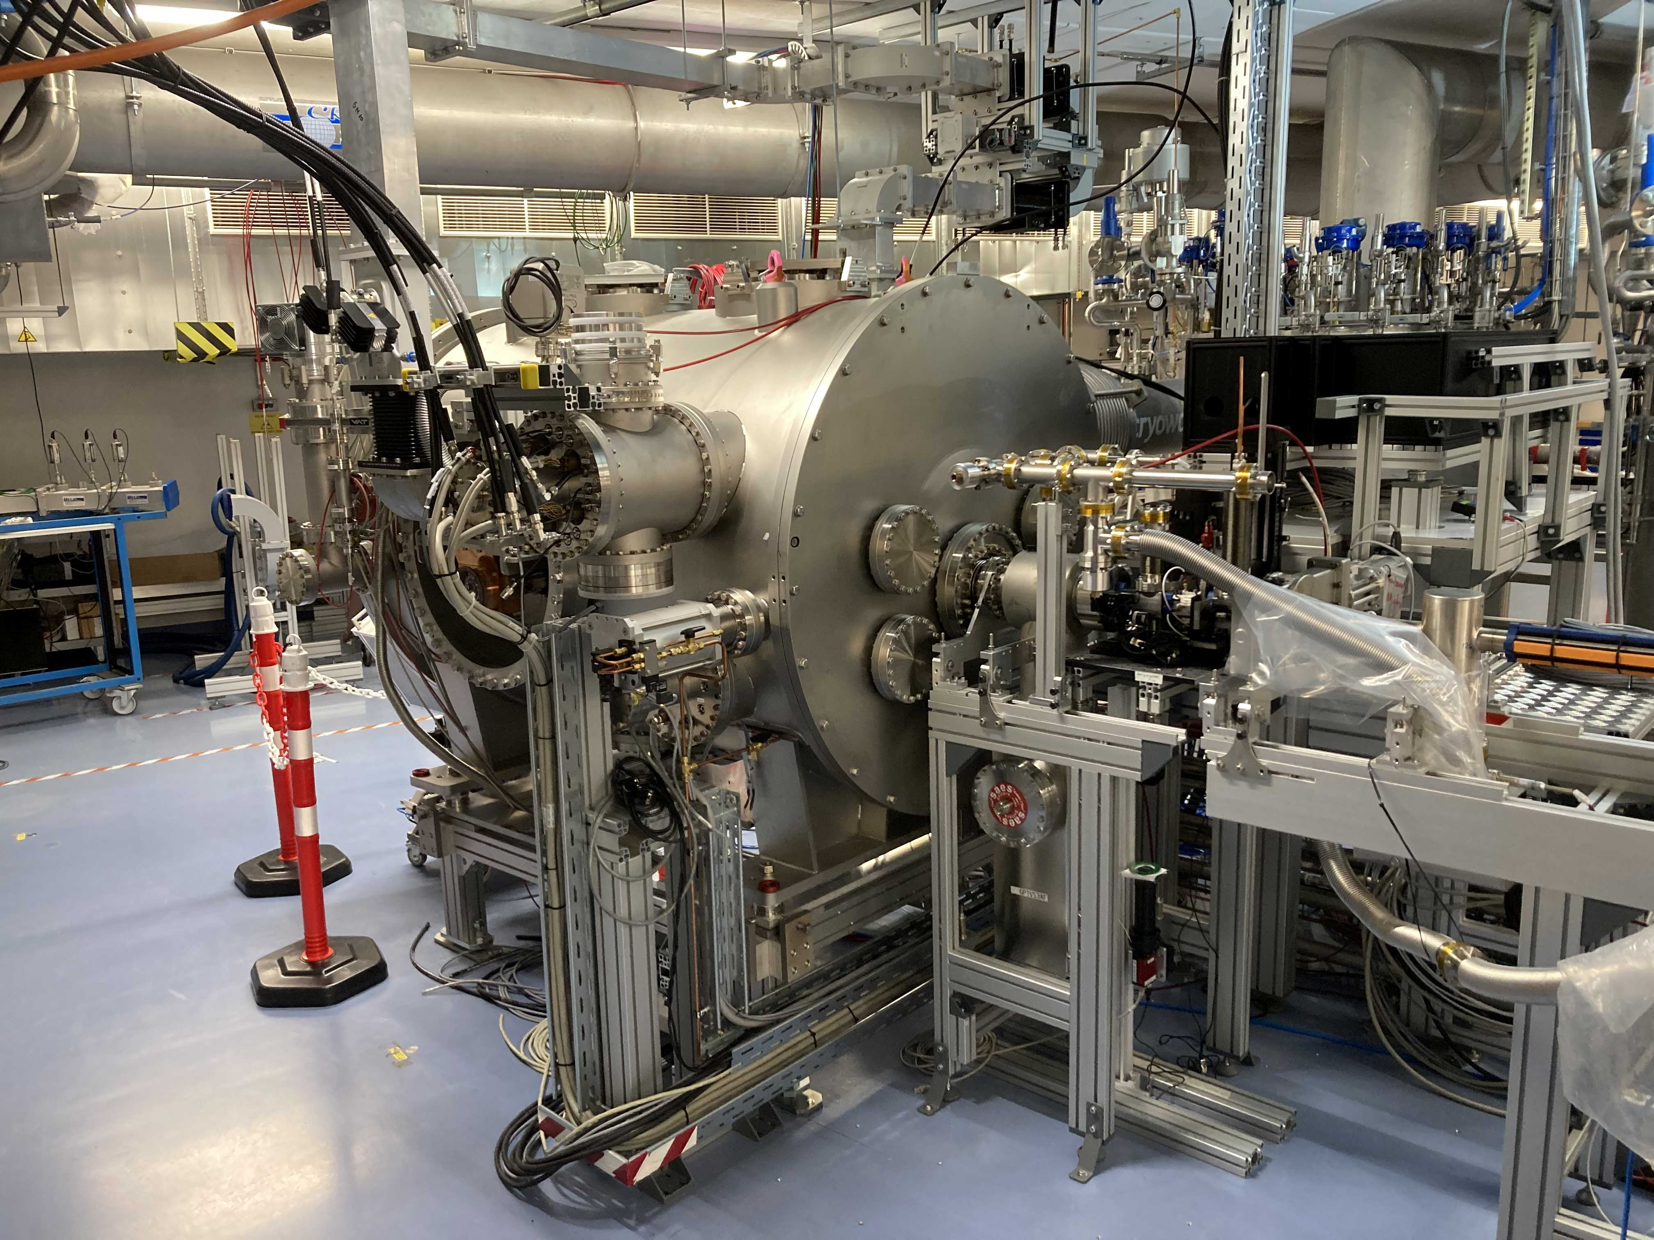
Status of bERLinPro
Injector installation at present
Beam diagnostics
SRF gun
Merger section
Cathode
transfer
system
SRF booster
“1st meter” diagnostics +
Laser window for laser-beam transport
Recirculator
SRF photo-injector and diagnostics ready for commissioning
Final preparation of cathode-laser beam transport
1.3 GHz laser demonstrated 23 W CW sufficient for 100 mA @ 2.5% QE
Cool-down in Jan. 2023 prerequisite for rad. permit application for RF operation
RF test of photoinjector Q2 2024 prerequisite for rad. permit application for beam operation
Cathode-transfer unit ready for installation following RF test
Beam operating permit expected Q3 2024 → First beam from SRF Gun around 10-11/2024
Start of Booster assembly H1/2024 (all parts in house)

Slide 9
Status of bERLinPro
Injector installation at present
Beam diagnostics
SRF gun
Merger section
Cathode
transfer
system
SRF booster
“1st meter” diagnostics +
Laser window for laser-beam transport
Recirculator
SRF photo-injector and diagnostics ready for commissioning
Final preparation of cathode-laser beam transport
1.3 GHz laser demonstrated 23 W CW sufficient for 100 mA @ 2.5% QE
Cool-down in Jan. 2023 prerequisite for rad. permit application for RF operation
RF test of photoinjector Q2 2024 prerequisite for rad. permit application for beam operation
Cathode-transfer unit ready for installation following RF test
Beam operating permit expected Q3 2024 → First beam from SRF Gun around 10-11/2024
Start of Booster assembly H1/2024 (all parts in house)

Slide 10
Status of bERLinPro
Injector installation at present
Beam diagnostics
SRF gun
Merger section
Cathode
transfer
system
SRF booster
“1st meter” diagnostics +
Laser window for laser-beam transport
Recirculator
SRF photo-injector and diagnostics ready for commissioning
Final preparation of cathode-laser beam transport
1.3 GHz laser demonstrated 23 W CW sufficient for 100 mA @ 2.5% QE
Cool-down in Jan. 2023 prerequisite for rad. permit application for RF operation
RF test of photoinjector Q2 2024 prerequisite for rad. permit application for beam operation
Cathode-transfer unit ready for installation following RF test
Beam operating permit expected Q3 2024 → First beam from SRF Gun around 10-11/2024
Start of Booster assembly H1/2024 (all parts in house)

Slide 11
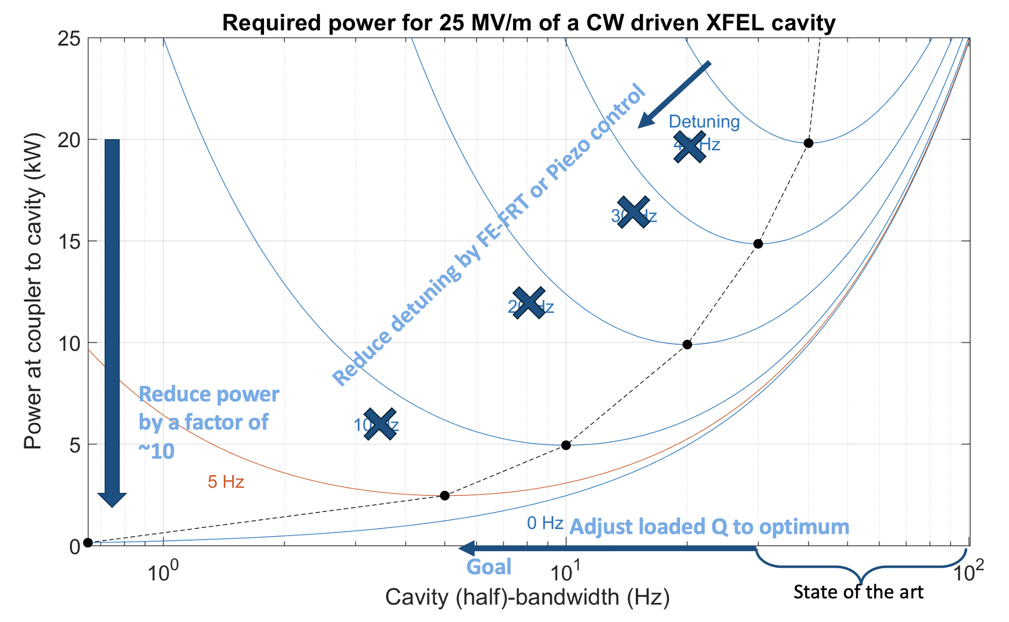


Further R&D to improve accelerator efficiency
From A. Neumann et al.,
Phys. Rev. ST Accel. Beams 13, 082001 (2010)
Compensation of disturbances in the acoustic frequency regime
This project has received funding from the European Union’s Horizon Europe research and innovation program under grant agreement No 101131435

Slide 12

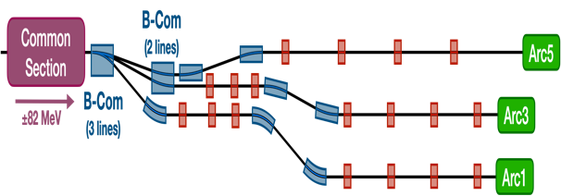
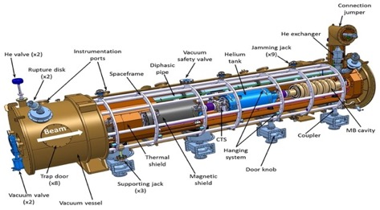
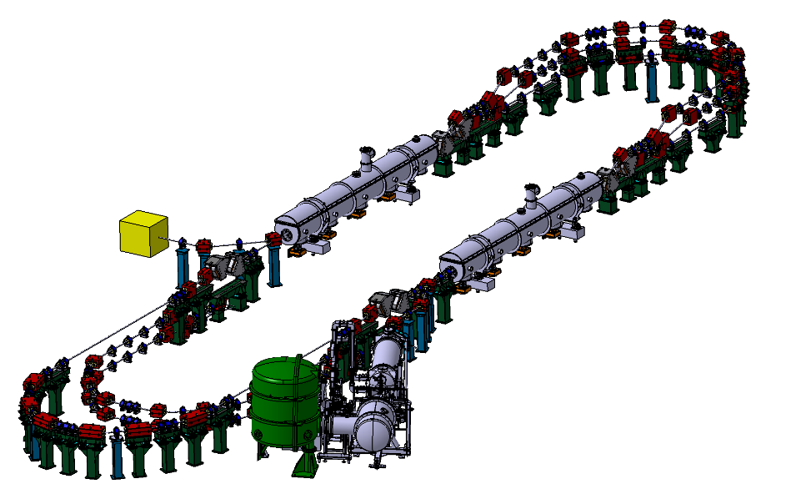
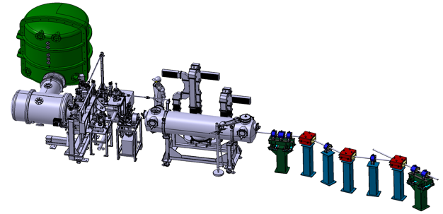








PERLE @ IJCLab-Orsay
PERLE: first multi-turn ERL, based on SRF technology, designed to operate at 10MW (20 mA, 500 MeV) power regime
→ A hub to explore a broad range of accelerator phenomena and to validate technical choices improving accelerators efficiency in an unexplored operational power regime on the pathway of the ERL technology development for future energy and intensity frontier machines.
Cryomodule with 4 five-Cell cavities
Total gradient 82 MeV
3 acc & 3 decc beams at different energies travelling in the CM.
Switchyard: vertical separation/recombination of beams at different energies
Target Parameter | Unit | Value
Injection energy | MeV | 7
Electron beam energy | MeV | 500
Normalised Emittance γε_{x,y} | mm mrad | 6
Average beam current | mA | 20
Bunch charge | pC | 500
Bunch length | mm | 3
Bunch spacing | ns | 25
RF frequency | MHz | 801.58
Duty factor |  | CW
Beam dump
3 staked isochronous recirculation arcs for beams at different energies (Arcs 1, 3, 5).
Interaction Points
HV tank
Photocathodes loading chamber (Sb-based photocathodes)
Buncher
350-500 kV
DC gun
Merger
3 staked (& inversed) isochronous recirculation arcs for beams at different energies (Arcs 2, 4, 6)
Light box
Green laser 40 MHz
Booster: 5 single-cell cavities (802MHz) individually powered
Injection line delivering 500pC bunches at 7 MeV.

Slide 13
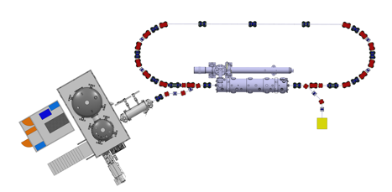
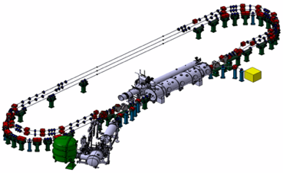
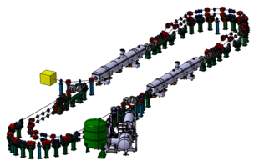
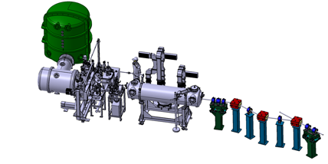
PERLE Timeline (macroscopic view)
Single turn ERL phase
→ Phase 1 to be extended to 2028
Prepare to Build phase (P2B): TDR and prototyping
Installation phases
Phase 1: Injection line Installation
Phase 2: PERLE 250 MeV version
Phase 3: PERLE 500 MeV version
2020
2021
2022
2023
2024
2025
2026
2027
2028
2029
2030
2031

Slide 14
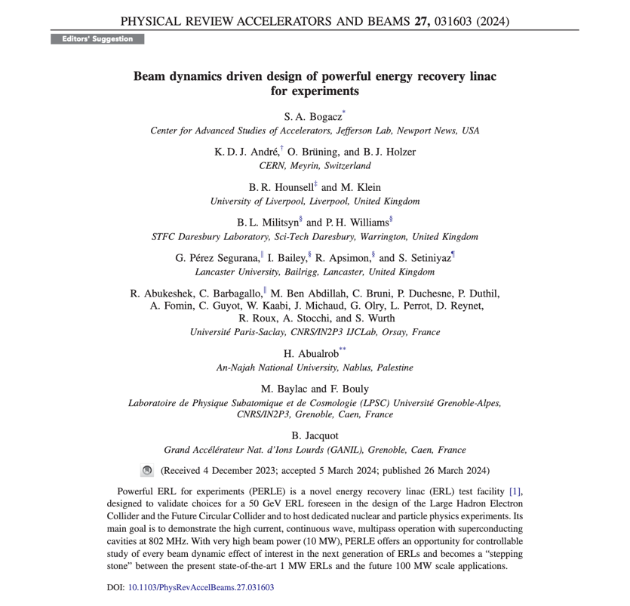
Recent paper of PERLE collaboration (centered on beam dynamics)
The first paper on Beam Dynamics and PERLE Design has been published in Physical Review Accelerators and Beams (PRAB) and was also selected as a « PRAB Editors Suggestion » on the journal homepage alongside other highlighted articles: https://journals.aps.org/prab
The following studies was reported in this paper for the 500 MeV version of PERLE:
  Lattice architecture and optics
  Staging construction
  Injector and merger, space charge study
  Longitudinal matching
  Filling pattern and bunch timing options
  Start to end simulations with CSR and Wakefield
  BBU study

Slide 15
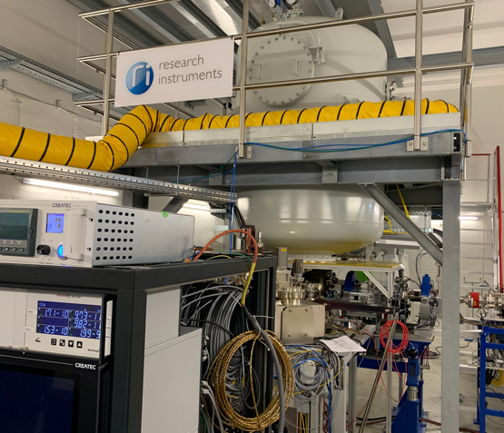
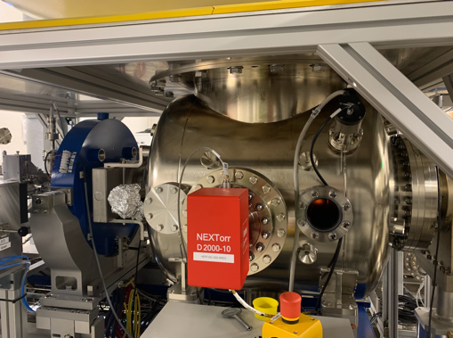
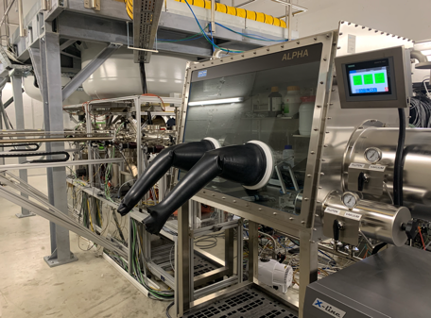
PERLE e- Source
Collaboration IJCLab-LPSC & RI GmbH
Within a Collaboration Agreement for photoinjector R&D between IJCLab (IN2P3) and Research Instruments GmbH (RI), Hardware of lighthouse project (terminated) transferred to IJCLab for PERLE. The gun was commissioned and tested at high rep rate, at a limited bunch charge. It includes:
A DC Gun, Cornell design (400 pC, 50 MHz demonstrated), fully equipped (all pumps) in load-lock version
A Photocathode Preparation Facility (PPF)
HV power supply suited for high bunch charge (designed for 40 mA, 450 kV)

Slide 16
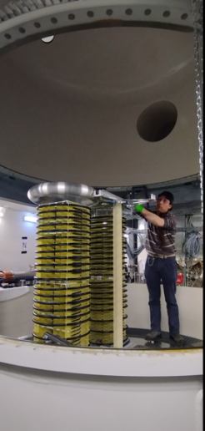
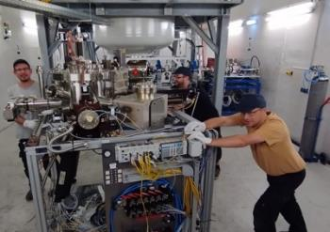
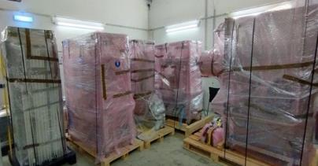
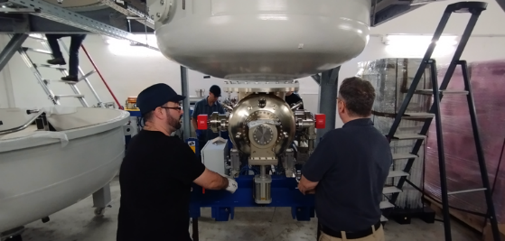
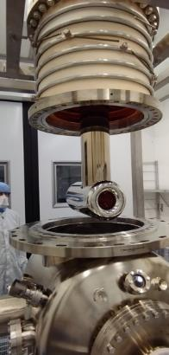
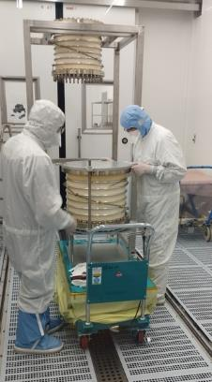
PERLE e- Source
Dismantling of the PPF (September 2023)
Dismantling of the PPF (September 2023)
Dismantling of the HV Columns tanks
Dismantling of the platform done by Baumann (November 2023)
Dismantling of the HV Columns tanks
Dismantling of the platform done by Baumann (November 2023)
Gun status : dismantling of the gun in clean room (January 2024)

Slide 17
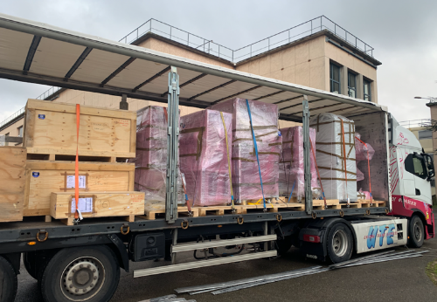
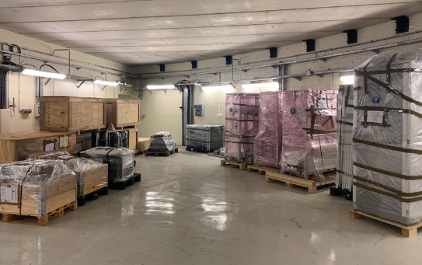
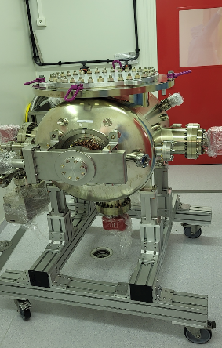
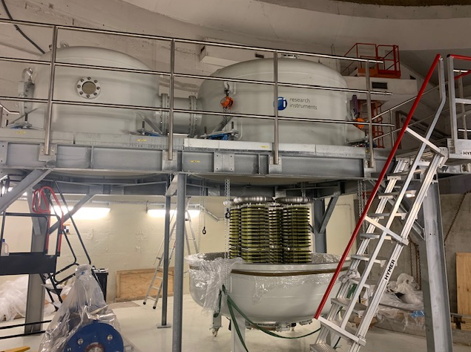
PERLE e- Source
The equipment were received at Orsay end of January
The re-installation at IJCLab is well advanced

Slide 18
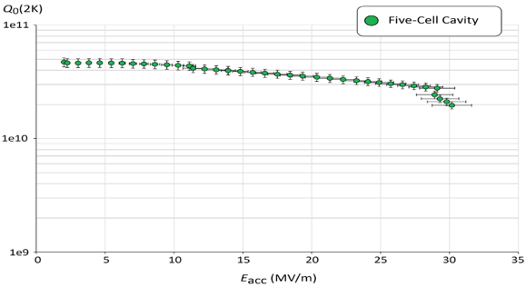
PERLE SRF cavity : reminder
Collaboration IJCLab-CERN and JLab
PERLE Requirements | Impacts | Challenges | Possible Solutions
CW operation (RF) | High dynamic losses | The highest cavity Q₀ | Cavity post-treatment (Doping, infusion…)
High current operation | High HOMs excitation | Efficient HOMs extraction & damping | Act on cavity design: low frequency cavity choice (< 1GHz), larger cavity aperture, fewer cells for the a given gradient, optimisation of end-cell design.
Muti-bunches operation | Increase beam instabilities | The highest BBU threshold | Regular spacing of bunches: optimisation of the bunch filling pattern during Lattice design + BBU study after HOM optimisation (including collective effects).
Q₀ (2k) = 3 e10 @ ~27 MV/m
Quench @ E_{acc} ~ 30 MV/m
PERLE requirements
First Nb 802 MHz 5-Cell cavity fabricated @ JLAB
F. Marhauser et al. “802 MHz ERL cavity design and development”- IPAC2018 (Vancouver, BC, Canada)- doi:10.18429/JACoW-IPAC2018-THPAL146

Slide 19

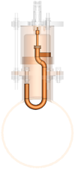
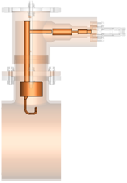
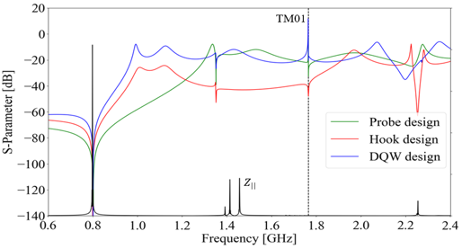
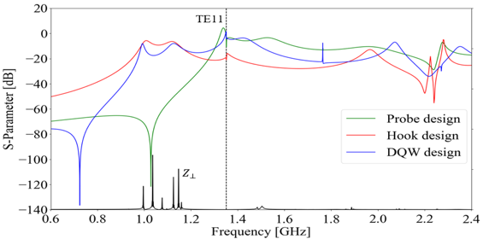
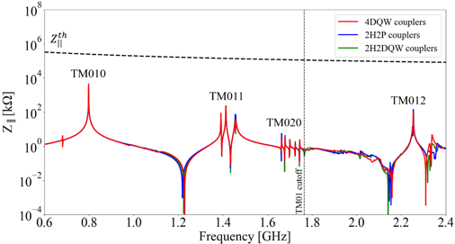
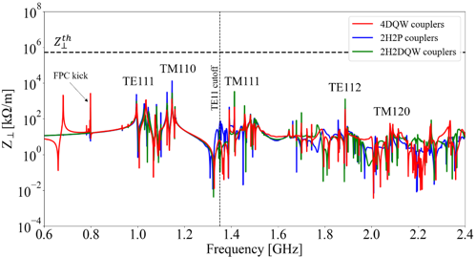
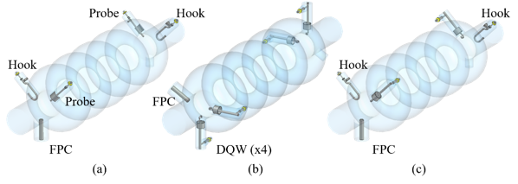
Status of HOM studies : news
HOM coupler optimization of 3 different designs
Collaboration IJCLab-Jlab and CERN
Monopole transmission
Dipole transmission
TM010
Optimized region
Probe Coupler
Hook Coupler
DQW Coupler
Optimized region
TM011
TM110
TM012
TE111
TM111
Couplers were geometrically optimized according to HOM spectrum ($Z_{||}$and $Z_{⊥}$) & S-parameters btw port 1 (beam pipe) & port 2 (coupler output) were studied.
The hook coupler provides higher damping of the first two dipole passbands (TE111 and TM110)
The DQW coupler exhibits a better monopole coupling for TM010 mode than the probe design.
Study of 2 damping schemes with 4 HOM couplers (Especially for dipole HOM extraction)
Longitudinal impedance spectra of the cavity
Transverse impedance spectra of the cavity
beam
beam
→ Promising results of the 4 DQW scheme: It allows damping both monopole and dipole HOMs below the analytically-computed beam-stability limits

Slide 20
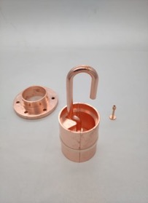
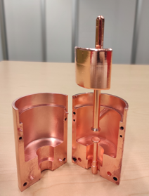
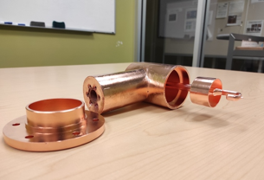
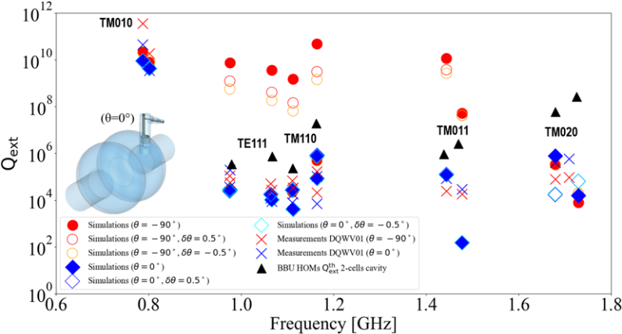
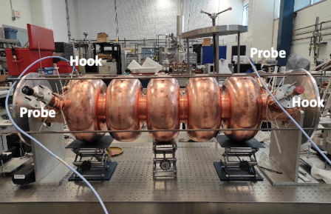
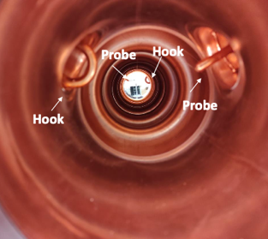
Status of HOM studies : news more details
From RF design to performance measurements: Successful collaborative effort between IJCLab, Jefferson Lab & CERN
Probe coupler
DQW coupler
Hook coupler
3D-printed prototype (Epoxy Accura 48) copper-coated @CERN
Ultimately, we aim to produce Nb HOM couplers with optimised design and to install them on a new Nb 5-cell PERLE cavity with optimised end groups. The Production of 4 cavity scheduled within the ISAS program (Starting from 2024).
C. Barbagallo et al. “First RF measurements of coaxial HOM coupler prototypes in a copper cavity for the PERLE project”- IPAC’23- MOPA025

Slide 21
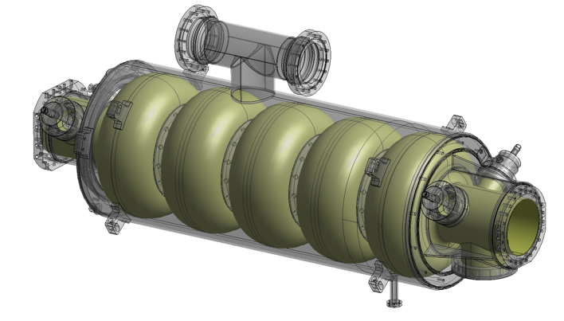
SRF cavity : latest news
Current work:
Specifications of the 5-Cell 800 MHz cavity is under finalisation.
A review meeting on the cavity post-production processes recipes (EP, BCP, Mid-T baking…) was organised end of March with international experts.
Within iSAS program:
The Nb procurement procedure will be lunched end of July (for single and multi-cell cavities).
It is foreseen to lunch the procurement procedure of four 5-cell cavities in fall 2024.
IJCLab, JLab, CERN and including now LASA-Milano

Slide 22

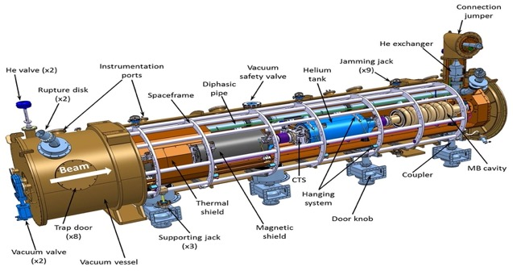
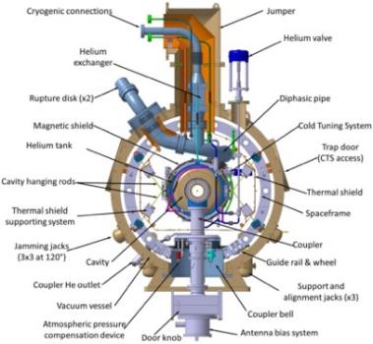
Cryomodule design
April 15-16, 2024: Kick-off of the European project ISAS (Innovate for Sustainable Accelerating Systems)
https://indico.ijclab.in2p3.fr/event/9521/
WP6: Integration of RF systems (SRF Cavities, HOM couplers & absorbers, Fundamental Power Couplers) optimized and developed within ISAS project into the 1st Cryomodule for PERLE- Foreseen for 2027
The cryomodule adapted from ESS design, will be optimised for efficient high current ERL operation.
ESS, CEA and INFN-LASA
involved in this work
The 2nd Cryomodule of PERLE: Foreseen after 2030
May include some/all the technologies studied within iSAS program to improve the efficiency of Cryomodules: Ferro-electric Fast Reactive Tuner (FE-FRT) for microphonics mitigation, LLRF managed by AI and 4.2 K Cavities operating.
This project has received funding from the European Union’s Horizon Europe research and innovation program under grant agreement No 101131435

Slide 23
Thank you for your attention!

Slide 24
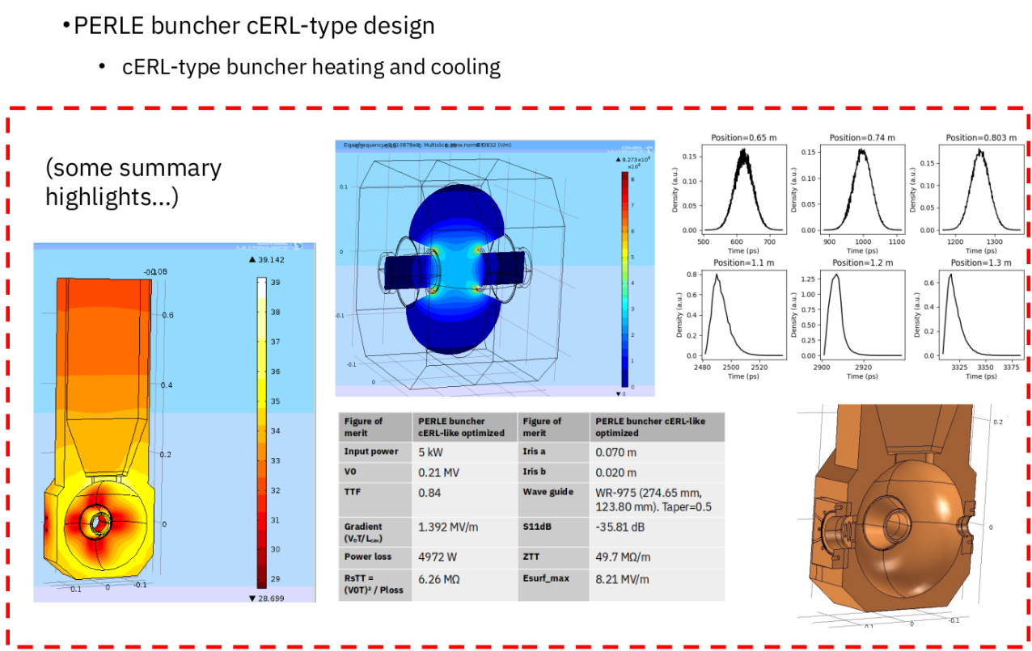
Buncher cavity design
Collaboration IJCLab-ESS Bilbao
Important progress in the RF design, thermal and beam dynamics simulations of a buncher cavity for PERLE by colleagues from ESS-Bilbao.

Slide 25
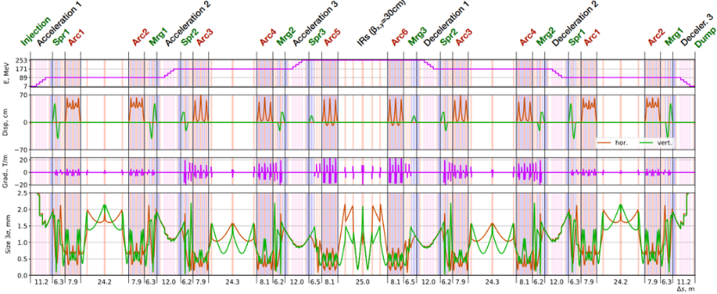







Magnet Design
Misalignments and Corrections
S-bend in Arcs
B-com in Spreader
163 mm
333 mm
Effect of quads misalignments on x-orbit
Before/after correction (with kickers)
500 mm
Positions of the diagnostic elements
BPM
BPM
BPM
BMP1
IJCLab, LPSC, Jlab, An-Najah
BMP3
BMP2

Slide 26


SRF cavity : latest news
Discussions/work with Jlab & CERN to pursue the R&D on 802 MHz cavities (Synergy with FCCee):
→ Optimisation surface treatment recipe (Mid-T baking, EP/PCB) and cold tests.
→ A CERN single-cell cavity fabricated by Jlab was received at IJLab end of May.
→ A common single-cell shape will be adopted for FCCee R&D and PERLE booster.

Slide 27





Site implementation
After site studies of the the two possible locations to host PERLE (Super ACO hall and Igloo):
The IGLOO was the preferred solution. Progress on Infrastructure and safety issues
Laser clean room: delivered in July 2024
Implantation in igloo being finalized

Slide 28
PERLE Timeline (macroscopic view)
PERLE
PERLE signle tour
PERLE 3 tours 250 MeV
PERLE 3 tours 500MeV
2020
2021
2022
2023
2024
2025
2026
2027
2028
2029
2030
2031

Slide 29












Conclusions and remarks
PERLE@Orsay : International collaboration formed
Recently extended within iSAS for cryomodule work
PERLE@Orsay proceed by phases :
  Phase 1: Injection line Installation + Single turn (2028)
  Phase 2: PERLE 250 MeV version (2030)
  Phase 3: PERLE 500 MeV version (> 2030)
PERLE@Orsay : Recent achievements
  The site is chosen : IGLOO. Progresses on Infrastructure and Safety issues
  Installation of the DC gun started – will be finalised by end 2024, commissioning in 2025.
  Significant progresses in buncher design.
  A common single-cell shape cavity will be adopted for FCCee R&D and PERLE booster.
  Progresses on magnet design and orbit corrections / diagnostic
  Specifications of the 5-Cell 800 MHz cavity is under finalisation. Procurement of 4 cavities before summer 2024
  The cryomodule adapted from ESS design. Significant progress → in phase with the 2027 delivery (iSAS)
PERLE@Orsay
  Human resources significantly increased (permanent researchers, technical staff, Post-Doc & PhD)
  Financial support for Phase 1 (single tour) strongly depends on the succes of ERL4ALL
+ Contributions through iSAS of
Still opened to new comers

Slide 30
Important discussions / actions on going
We have proposed a project (ERL4ALL) to CNRS which should allow to finance the full injection line and a part of a first tour equipment. Money required 3M€. Led by Maud Baylac , Walid Kaabi, Eliane Bouquelrel We received a first green light and the project will be presented the 27 June for final decision/approval.
Discussions well advanced with HZB to recuperate part of the equipment of BESSY VSR - Cryogenic plant, valve box and transfer lines. Recuperation of all materiel by Summer 2026.
Discussion on going for receiving in-kind some material from CBETA (quadrupoles essentially to equip the first tour of PERLE)
Increasing collaborations with
  CERN (R&D on 800MHz SRF Cavities (FCC) : production and post-production processes. Discussion well advanced
  LASA-Milano (cavities LINAC Cryomodule, booster, DC-gun/photocathode). Discussion started
  Jlab (Hom/Absorbers/cavities). Discussion on going

Slide 31
Challenges toward PERLE realisation
Development of high current electron sources:
DC gun: high charge production at high repetition rate, high cathode field & high vacuum
New photocathode materials with high quantum efficiency and long life time (CsKSb, GaAS…)
Beam dynamics & instrumentation:
Specific simulation tools for ERL adapted to high-power beams at different energies and currents
Development of high dynamic range instrumentation allowing high beam control at different functioning phases (commissioning, ramping-up and operation), and also to decern beams from “undesired” one (halo):
  Non-invasive diagnostics: optical system for beam imaging
  BPMs and BAMs adapted to multi-turn
  Sensitive BLMs for the monitoring of beam loss and beam halo
SRF Cavity and High Order Mode (HOM) damping:
For operation in CW mode with the minimum dynamic loss, cavity should have the highest Q₀: Thermal treatment (Doping, infusion, medium temperature annealing) or R&D on SRF material for 4,2K operation (Nb3Sn or others…)
Development of Fast Reactive Tuners (FRTs) adapted to cavity and cryomodule to mitigate cavity detuning by microphonics.
Efficient HOM extraction w/o increasing cryoload, to preserve beam quality & avoid its disruption by wakefields
  Cavity design choices should integrate the HOM extraction issue: frequency optimisation, large aperture, few cells, optimised end group)
  Design of specific HOM couplers & optimisation of the damping scheme
  Study the need of additional absorber in the beam line

