Slide 1

Scientific Council on neutrinoless double beta decay
October 6, 2025. Morning session (IN2P3)
Marcella Grasso
Scientific Director
Nuclear and Hadronic Physics
CNRS Nucléaire & Particules, IN2P3

Slide 2
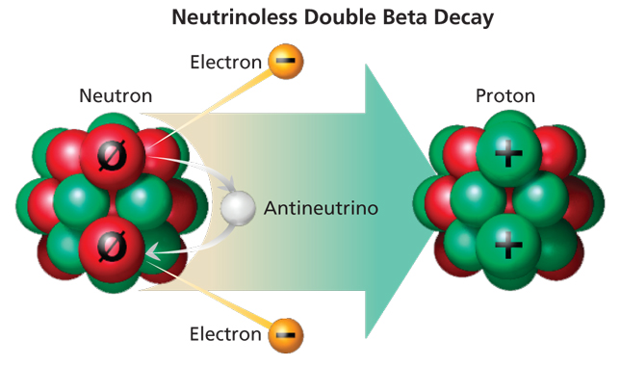
Why do scientists try to observe this rare and hypothetical nuclear decay?
Several scientific domains are involved and may be impacted
COSMOLOGY:
matter/antimatter asymmetry
If lepton number is not conserved ->
there may be an impact on matter/antimatter asymmetry
NEUTRINO PHYSICS:
the nature of neutrinos:
If this decay is observed ->
neutrinos are Majorana particles
PARTICLE PHYSICS:
new physics beyond the Standard Model
If this decay is observed ->
the total lepton number is not conserved
NUCLEAR PHYSICS:
to compute half-lives, nuclear matrix elements are necessary (theoretical nuclear approaches for the predictions).
If this decay is observed ->
test for models and the nuclear interaction (benchmark for example for ab-initio models)
High-impact science is expected!

Slide 3
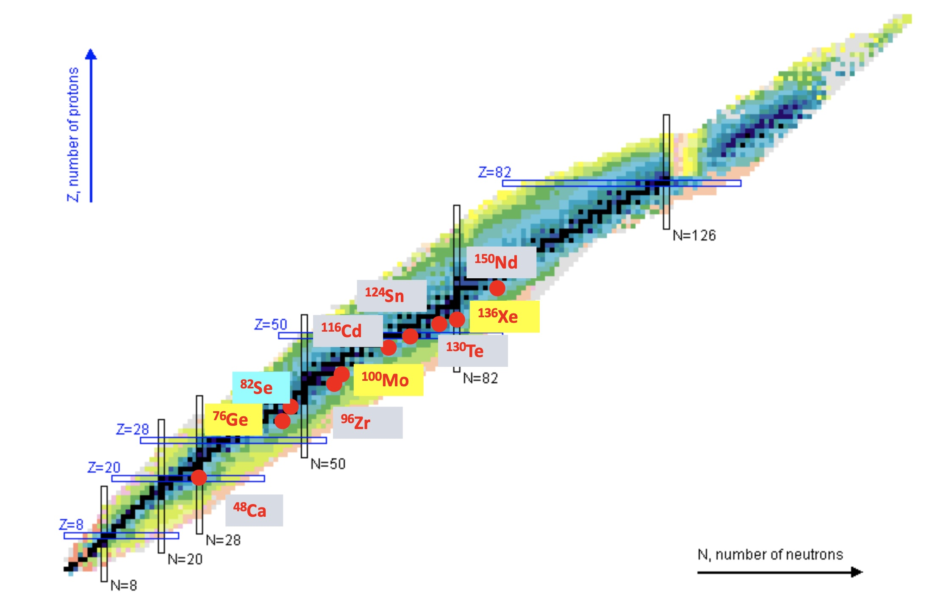
Neutrinoless double beta decay is included
in the Nuclear and Hadronic Physics portfolio since January 2024
IN2P3 presently aims to define a scientific strategy with structured and focused activities on an existing new-generation project, within an international collaboration. Different techniques are employed in these projects with, mainly, a focus on 3 isotopes: Ge (LEGEND), Mo (CUPID), Xe (nEXO)
Status at IN2P3 in January 2024:
SuperNEMO demonstrator under construction in Laboratoire Souterrain de Modane (LSM) (with ⁸²Se)
Some interest in nEXO at SUBATECH
R&D activities (R2D2)
CUPID (collaborations with CEA)

Slide 4
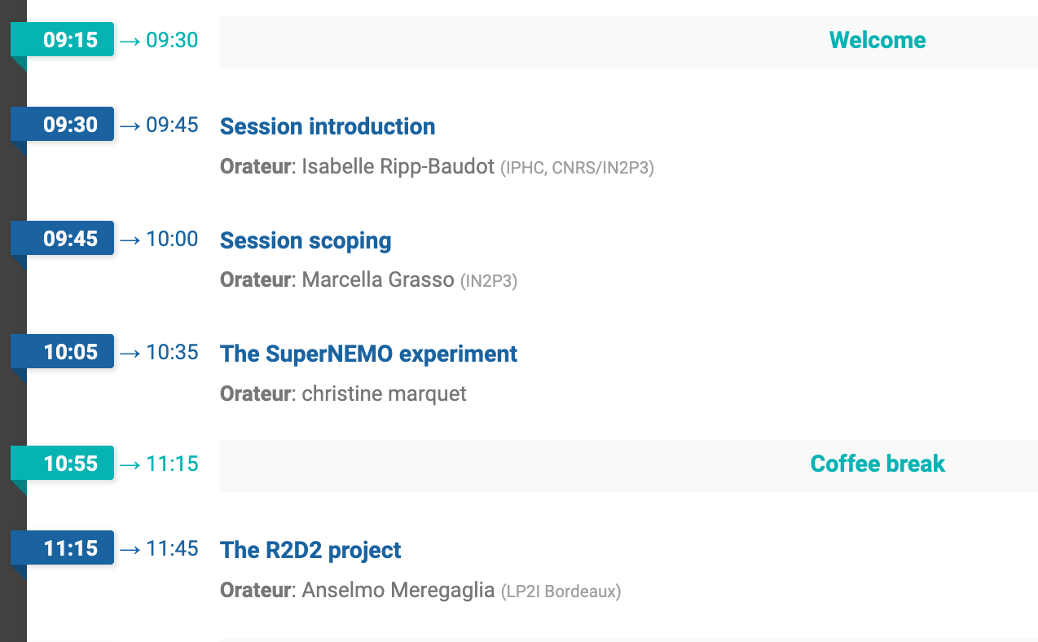
IN2P3 Scientific Council. October 6 2025.
Morning session. Only IN2P3
SuperNEMO: an information point
Data taking started in Spring 2025
Dismantling is expected to start in January 2027 (exchanges with the collaboration)
Un update will be done after 1 year of data taking (Spring 2026)
R2D2 is presented today for information and evaluation
IN2P3 asks CSI members to address in particular some specific points

Slide 5
R2D2 (Rare Decays with Radial Detectors): R&D activity at IN2P3 since several years.
IN2P3 suggests the following points to be addressed:
Strengths and weaknesses of the instrumental developments carried out over the past years in the framework of R2D2
Impact of the R2D2 R&D on the expertise at the institute: what have been the benefits?
The international context for future new-generation neutrinoless double beta decay projects evolved over the last years. International collaborations have mainly focused on a few projects.
What is the place of R2D2 in this context?
How do R2D2 activities compare to these projects in terms of competitivity in the expected performances, competitivity in the timeline, level of maturity?
What scientific impact would be expected and how could it be achieved? What would be needed?
FTEs dedicated to R2D2. Where and how? Commitments of the teams to other projects

Slide 6
Thank you

