Slide 1
13th ICFA Seminar on
Future Perspectives in High-Energy Physics
Energy Recovery Linac research and facilities
Walid Kaabi (IJCLab-CNRS)
DESY-Hamburg, 30 November 2023

Slide 2
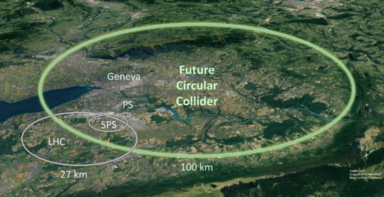

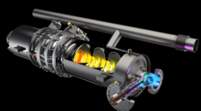

Introduction: Average power needs for future HEP projects
Example: FCC-ee (ZH) @250 GeV, CW, (0.4 & 0.8) GHz
60% efficiency
Grid to DC: 90%
RF power generation!
RF distribution!
losses in cavities
RF to beam
The power consumption for a e+ e- Higgs factory is 300 MW, Nearly 2 TWh for a typical yearly operating cycle.
This represent 2 to 3% of the annual consumption of some European countries as Belgium, Finland and Netherland.
For this facility, the power needs is distributed as the following:
  RF for beam acceleration 51% (145 MW)
  Cryogenic cooling 5% (14 MW)
  Magnets 9% (26 MW)
  Others 35% (98 MW)
Sankey diagram (Exp: FCC-ee ($t\overline{t}$))
FCC CDR, Eur. Phys. J. Special Topics 228, 261–623 (2019)

Slide 3
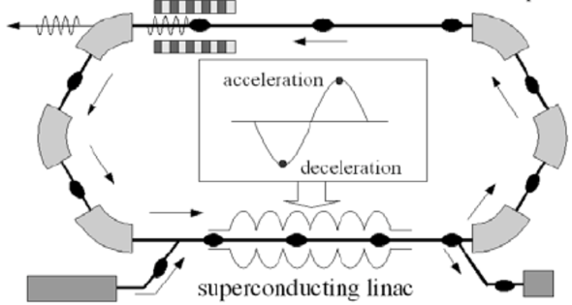
Introduction- ERL Concept
Acceleration:
RF power provided to cavities
The idea:
ERL Loop
(1’)
(1)
New beam injected in ERL loop
Acceleration to the top energy
(2’)…
(2)
acceleration
deceleration
ERL Loop
Kinetic energy of used beam recycled to re-excite cavities
Superconducting Linac
(4)
Beam used in IP
(3)
Injector
Beam dump
The benefits:
Reduce accelerator power consumption
Dumping the beam at injection power
Fresh beam in IP with the same characteristics
Deceleration:
180° RF Phase shift
More advantages:
Linac-like beam quality with extremely flexible time structure
High operating efficiency
Multi-pass configuration: High average current carrying capability (no more RF power limit) + High average beam power in a compact machine

Slide 4
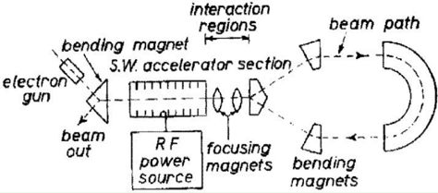
ERL History and achievements
1987 Los Alamos
FEL-operation, nc,
coupled acc/dec cavities
1987 High Energy Physics Lab
Stanford University
SRF cavities, proof of principal experiment
1965 M. Tigner
“A possible apparatus for electron clashing-beam experiments”
2000
Jefferson Lab
“Front End Test”
SRF, first CW
recovery
2017 Darmstadt Univ, Germany
“S-DALINAC”, SRF, single pass 22.5MeV,
2021
2 pass demonstration
2002 JEARI, Japan
FEL, SRF, 700kW beam power
2005 Daresbury Lab, GB
“Alice”, SRF, 26MeV, versatile
10-year user program
under construction:
MESA, Germany
particle physics application
PERLE, France
Technology test facility (LHeC/FCC-eh) + eRIB test facility
bERLinPro, Germany
SRF/ERL technology test facility
CeC, BNL, USA
Coherent electron cooling for EIC
2002
Jefferson Lab
“IR-Demo”
SRF, 5mA, 48MeV,
2.1kW beam power IR
2003
CEBAF, 1 GeV, single turn
2007 Upgrade:
9mA, 150MeV
1.1MW beam power with ~300kW total power
2004 BINP, Russia
FEL-operation
normal conducting RF,
30 mA
2007: 4-passes
2013 KEK, Japan
“cERL”, prototype
ERL light source
Industrial applications
2020, Cornell/BNL
cbeta, FFA-arc
4-pass ERL
(80mA injector, e = 0.3mm mrad)
Courtesy to Bettina Kuske

Slide 5
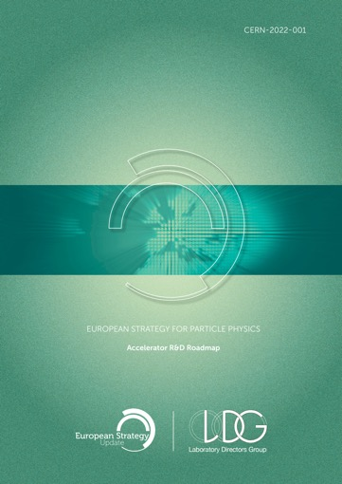
ERLs in the European Accelerator R&D Roadmap
ERL development has been recognized as one of the five main axis of accelerators R&D in support of the European Strategy for Particle Physics (ESPP):
  High-field magnets
  High-gradient RF structures and systems
  High-gradient plasma and laser accelerators
  Bright muon beams and muon colliders
  Energy Recovery Linacs
The ERL Roadmap Panel, chaired by Max Klein and Andrew Hutton, has done a tremendous job with broad and active participation. PERLE & bERLinPro projects were recognized as one of the "essential pillars of the ERL development," with milestones to be achieved by the next ESPP in 2026.
ESPP R&D Accelerator Roadmap: https://arxiv.org/ftp/arxiv/papers/2201/2201.07895.pdf

Slide 6
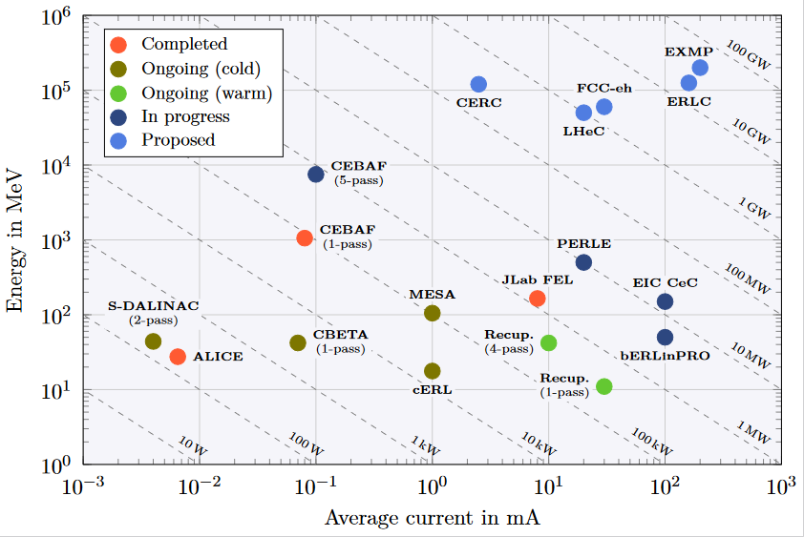
ERL - The global landscape
Funding Limited
Technology Limited

Slide 7
Challenges toward new generation of efficient ERL
Development of high current electron sources:
DC gun: high charge production at high repetition rate, high cathode field & high vacuum
SRF gun: high-brightness CW electron beams generation (high-charge, low-emittance bunches).
New photocathode materials with high quantum efficiency and long life time
Beam dynamics & instrumentation:
Specific simulation tools for ERL adapted to high-power beams at different energies and currents
Development of high dynamic range instrumentation allowing high beam control at different functioning phases (commissioning, ramping-up and operation), and also to decern beams from “undesired” one (halo):
  Non-invasive diagnostics: optical system for beam imaging
  BPMs and BAMs adapted to multi-turn
  Sensitive BLMs for the monitoring of beam loss and beam halo
SRF Cavity and High Order Mode (HOM) damping:
For operation in CW mode with the minimum dynamic loss, cavity should have the highest Q₀: Thermal treatment (Doping, infusion, medium temperature annealing) or R&D on SRF material for 4,2K operation (Nb3Sn or others…)
Development of Fast Reactive Tuners (FRTs) adapted to cavity and cryomodule to mitigate cavity detuning by microphonics.
Efficient HOM extraction w/o increasing cryoload, to preserve beam quality & avoid its disruption by wakefields
  Cavity design choices should integrate the HOM extraction issue: frequency optimisation, large aperture, few cells, optimised end group)
  Design of specific HOM couplers & optimisation of the damping scheme
  Study the need of additional absorber in the beam line

Slide 8
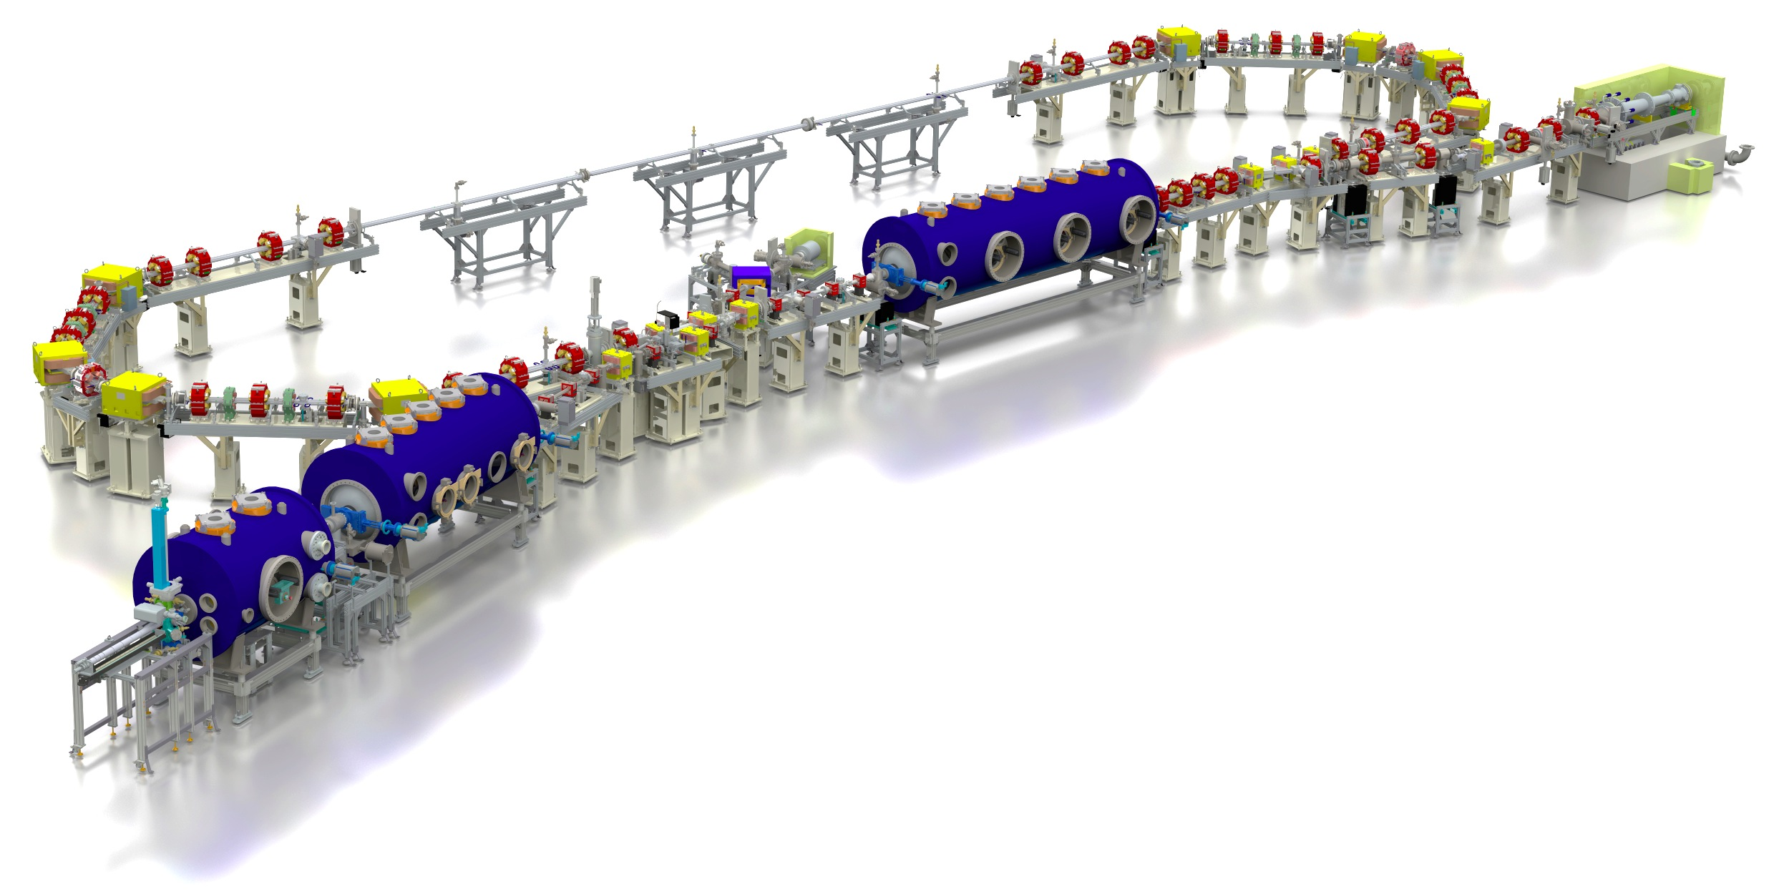
bERLinPro at SEALAB-HZB:
bERLinPro: A demonstration facility for ERL science and technology
New developments:
Beam dynamics and manipulation
(merger, recirculator, study beam break-up)
SRF systems: Photo-injector, high power
booster, HOM damped Linac
Electron source: High repetition laser system
high QE cathode development
Control of beam losses and
radiation protection
High power beam dump
High power CW RF
  Few 100 kW class
  klystrons → Power couplers!
  Some 10 kW solid
  state amplifier
Diagnostics, synchronization
machine protection, beam
loss monitoring
A stable Cryoplant
test and
diagnostic line
beam dump
6.5 MeV, 100 mA
= 650 kW
linac module
3 x 7 cell SRF cavities
44 MeV
merger
dogleg
modified Cornell booster
3 x 2 cell SRF cavities 4.5 MeV
SRF-gun
1.4 cell SRF cavities
1.5-2.3 MeV, single SC solenoid,
Parameter | bERLinPro
Beam energy recirculator (MeV) | 50
Beam current ERL mode (mA) | 100
Frequency RF and Laser (GHz) | 1.3
Normalized emittance (mm mrad) | 1 (< 0.6 in simulations)
Bunch length (ps) | < 2 (ERL mode), 100 fs @ 10 mA
Beam losses | << 10⁻⁵ @ 100 mA

Slide 9
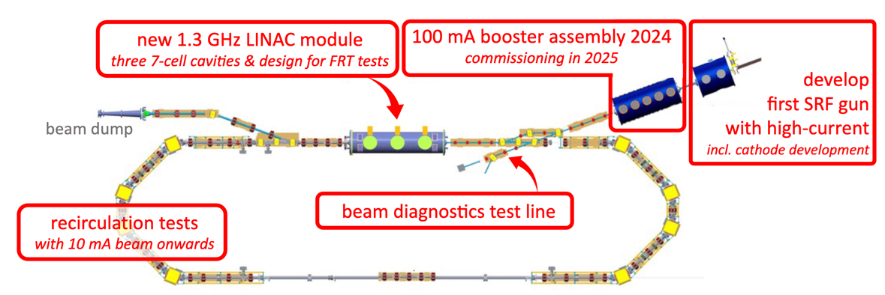
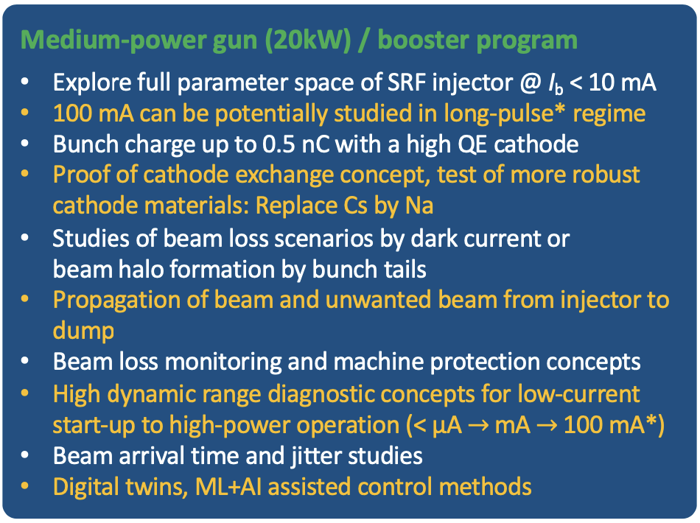
bERLinPro at SEALAB-HZB :
Effort is now focused on starting the commissioning of the 1st developed SRF gun (10 mA).
Contingent on additional budgets upgrades to 100 mA (new gun) and ERL at 50 MeV can be planned to be operational by 2028 (existing design for the Linac Cryomodule)

Slide 10
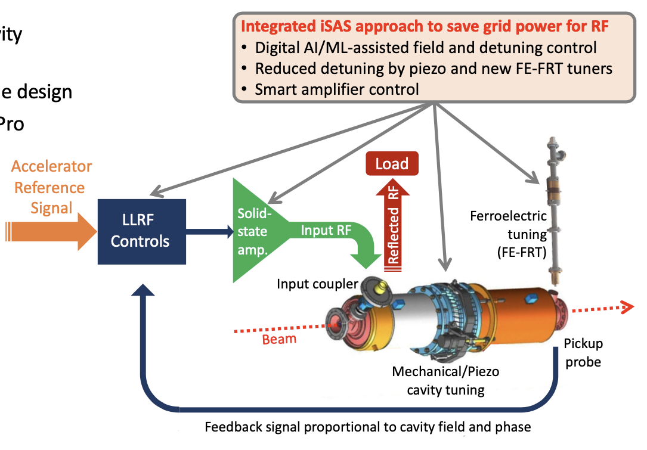
bERLinPro at SEALAB-HZB :
Meanwhile, important R&D effort is foreseen in the coming years (2024-2028) within iSAS project to develop new technologies that contribute to lower the energy bill and increase the efficiency of the accelerators.

Slide 11
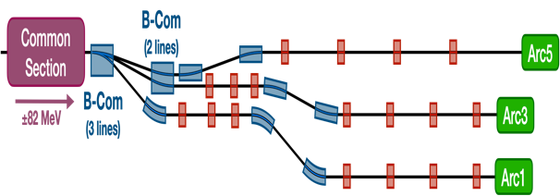
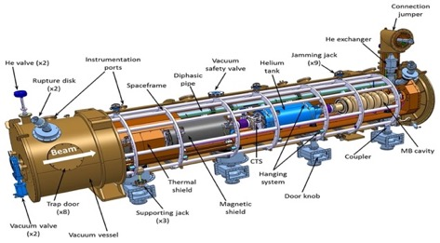
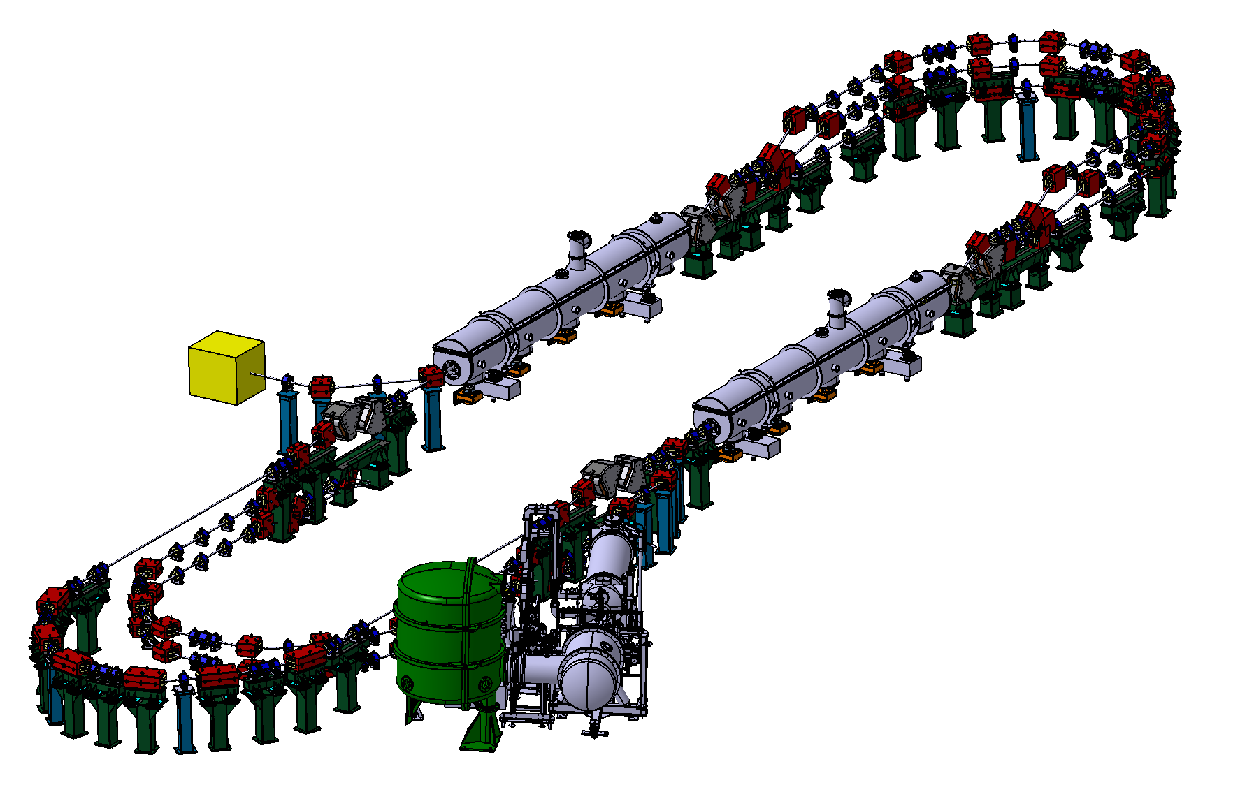
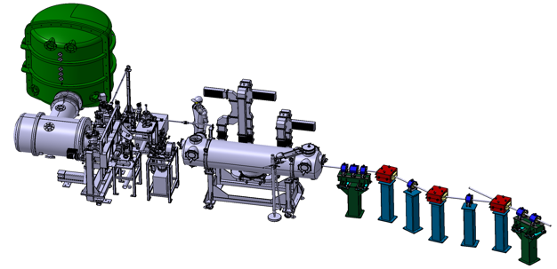








PERLE @ IJCLab-Orsay
PERLE: first multi-turn ERL, based on SRF technology, designed to operate at 10MW (20 mA, 500 MeV) power regime
→ A hub to explore a broad range of accelerator phenomena and to validate technical choices improving accelerators efficiency in an unexplored operational power regime on the pathway of the ERL technology development for future energy and intensity frontier machines.
Cryomodule with 4 five-Cell cavities
Total gradient 82 MeV
3 acc & 3 decc beams at different energies travelling in the CM.
Switchyard: vertical separation/recombination of beams at different energies
Target Parameter | Unit | Value
Injection energy | MeV | 7
Electron beam energy | MeV | 500
Normalised Emittance γε_{x,y} | mm mrad | 6
Average beam current | mA | 20
Bunch charge | pC | 500
Bunch length | mm | 3
Bunch spacing | ns | 25
RF frequency | MHz | 801.58
Duty factor |  | CW
Beam dump
3 staked isochronous recirculation arcs for beams at different energies (Arcs 1, 3, 5).
Interaction Points
HV tank
Photocathodes loading chamber (Sb-based photocathodes)
Buncher
350-500 kV
DC gun
Merger
3 staked (& inversed) isochronous recirculation arcs for beams at different energies (Arcs 2, 4, 6)
Light box
Green laser 40 MHz
Booster: 5 single-cell cavities (802MHz) individually powered
Injection line delivering 500pC bunches at 7 MeV.

Slide 12
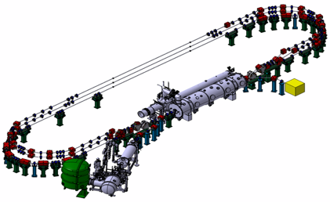
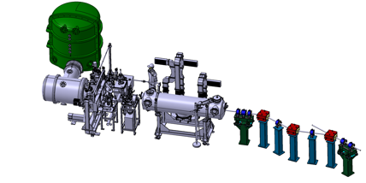
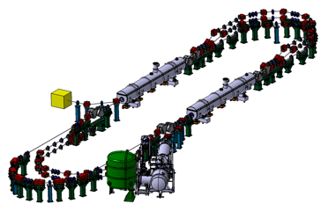
PERLE Timeline for TDR phase and beyond
Prepare to Build phase (P2B): TDR and prototyping
Installation phases
Phase 1: Injection line Installation
Phase 2: PERLE 250 MeV version
Phase 3: PERLE 500 MeV version
2020
2021
2022
2023
2024
2025
2026
2027
2028
2029
2030
2031

Slide 13
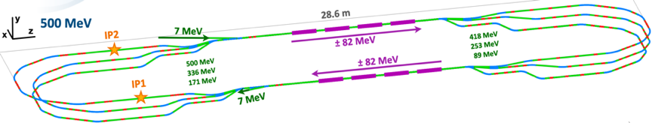
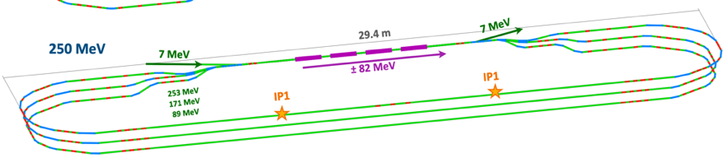
PERLE Lattice optimization
Lattices and optics for the 500 MeV and 250MeV PERLE versions were studied and optimised:
A full 1st order calculation were finished and a complete 250 and 500 MeV lattice is now available.
The stability of the lattice was crosscheck with different codes (OPTIM6, MADX & BMAD).
First specifications of quadrupoles and dipoles in switchyards & arc sections are obtained.
→ Further studies are ongoing/to be done: correction of nonlinear aberrations with multipoles, momentum acceptance, longitudinal match…
→ In addition to beam dynamics studies: Start to end simulations with CSR and microbunching, Multiparticle tracking, BBU, Impedance analysis and Wakefield effect mitigation …

Slide 14
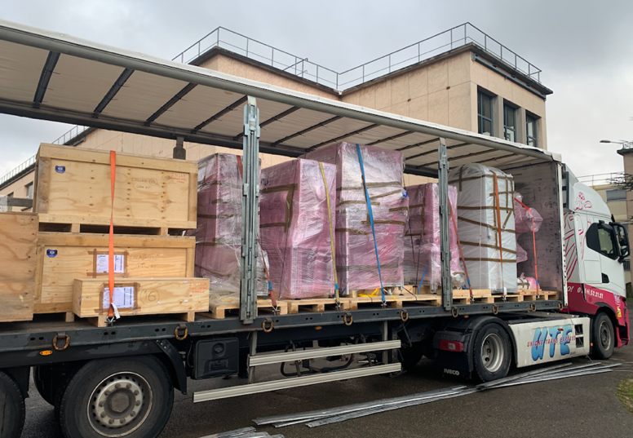
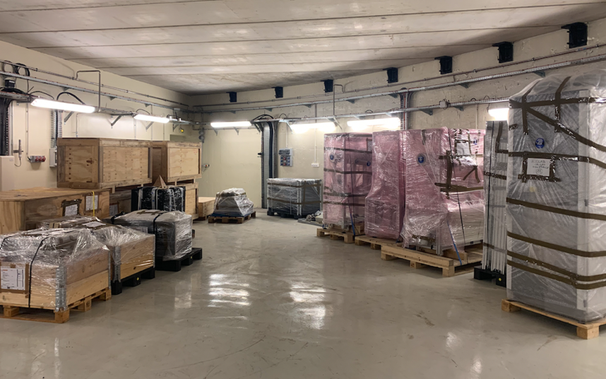
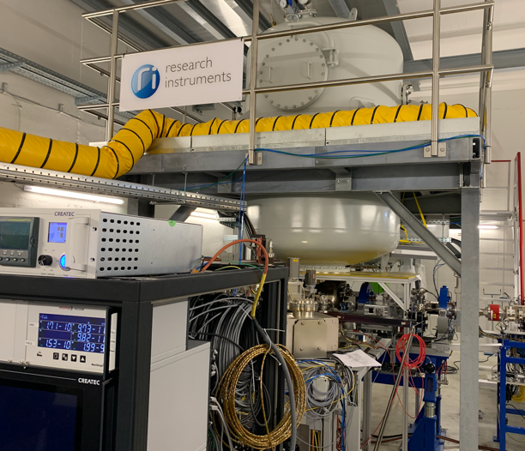
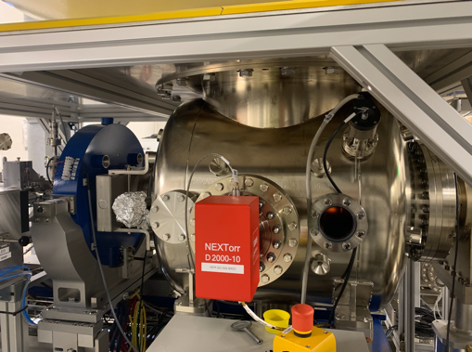
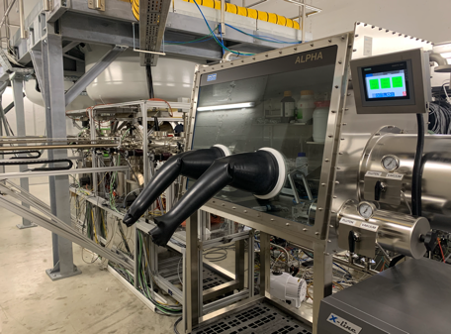
PERLE e- Source
Acquisition of a DC gun from Research Instruments GmbH (RI).
→ A Gun with Cornell design (400 pC, 50 MHz demonstrated), fully equipped, in load-lock version
Equipped with a Photocathode preparation facility
HV power supply suited for high bunch charge (designed for 40 mA, 450 kV)
The gun was commissioned and tested at high rep rate, at a limited bunch charge
The DC Gun was received at Orsay last week.

Slide 15
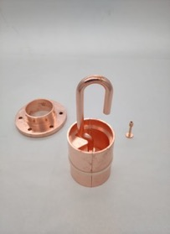
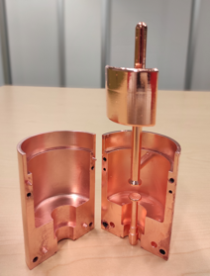
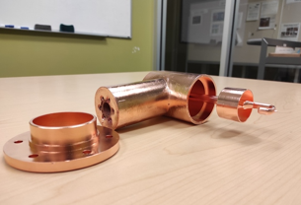
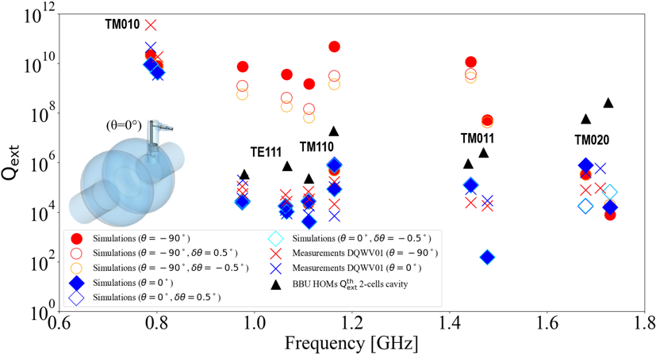
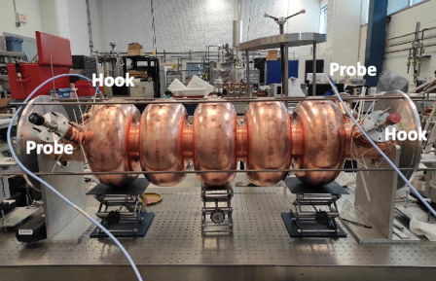
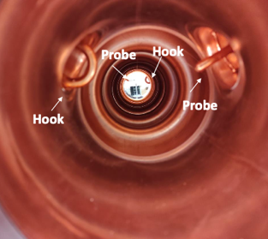
Status of HOM studies :
From RF design to performance measurements: Successful collaborative effort between IJCLab, Jefferson Lab & CERN
Probe coupler
DQW coupler
Hook coupler
3D-printed prototype (Epoxy Accura 48) copper-coated @CERN
Ultimately, we aim to produce Nb HOM couplers with optimised design and to install them on a new Nb 5-cell PERLE cavity with optimised end groups. The Production of 4 cavity scheduled within the ISAS program (Starting from 2024).
A 5-Cell copper cavity was fabricated @Jlab (same design as the Nb 5-cell cavity fabricated in 2017) to allow end group optimisation & test several HOM couplers combinations to assess the best HOM damping scheme.

Slide 16
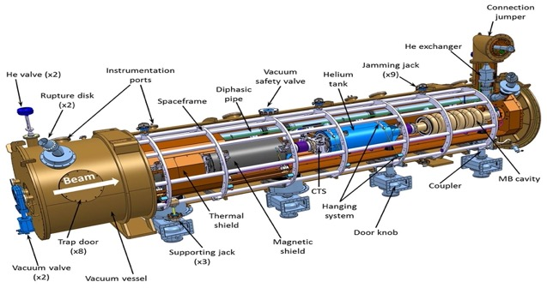
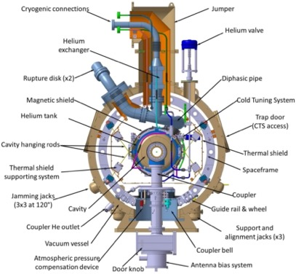
Cryomodule design:
ESS Cryomodule design was selected:
Intermediate supporting structure (spaceframe)
Cavity string hung by rods
Insertion of the cavity string by the extremity (rollers)
Trap doors for tuner access
Connexion to the valve box on the top of the vacuum vessel
Important space available inside
Design validated: series fab. & tests ongoing (Qty 30)
1st Cryomodule: Foreseen for 2027
Adapted from ESS design, it will be optimised for efficient high current ERL operation within the European Infra-Tech program iSAS*. It will host cavities equipped with HOM couplers and FPC optimised and developed within the same program.
2nd Cryomodule: Foreseen for 2030
May include some/all the technologies studied within iSAS program to improve the efficiency of Cryomodules: Fast Reactive Tuner (FRT) for microphonics mitigation, LLRF managed by AI and 4.2 K Cavities operating.
* More information on iSAS program: https://indico.ijclab.in2p3.fr/event/9521/

Slide 17
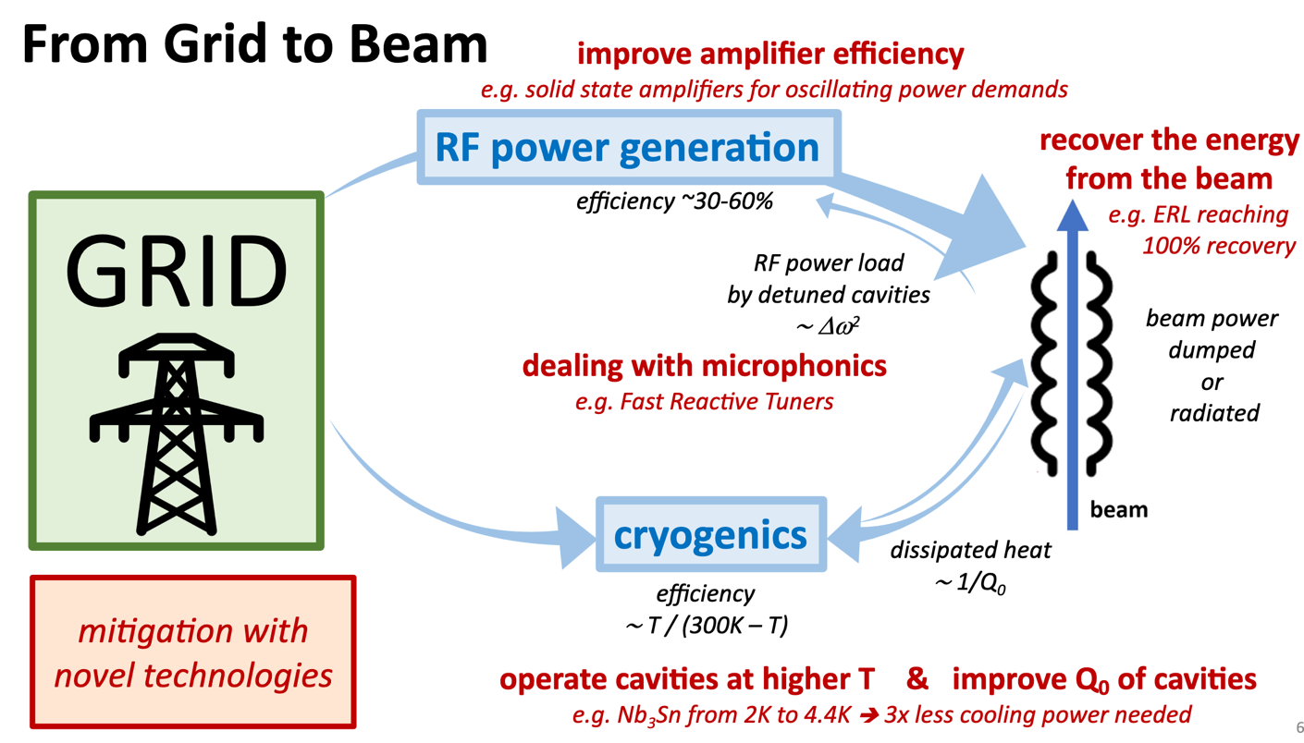
Innovation for Sustainable Accelerating Systems (iSAS*)
* iSAS: project supported by Horizon Europe

Slide 18
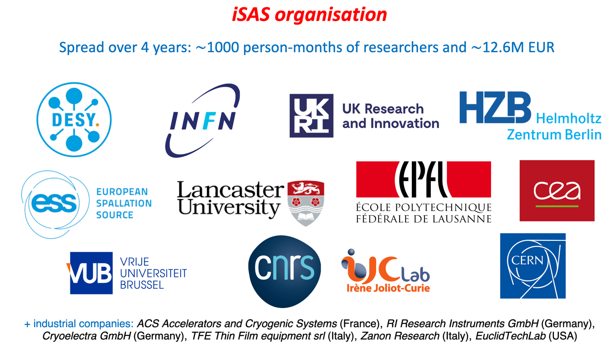
Innovation for Sustainable Accelerating Systems (iSAS)
More about iSAS: https://indico.ijclab.in2p3.fr/event/9521/
iSAS Collaboration

Slide 19
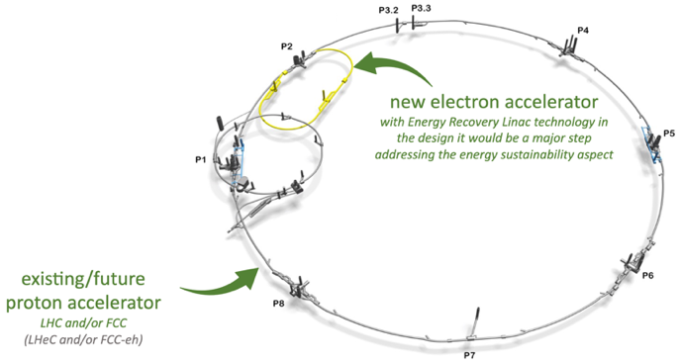
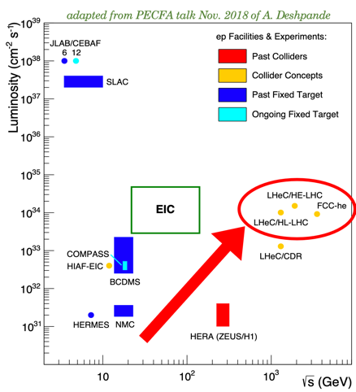
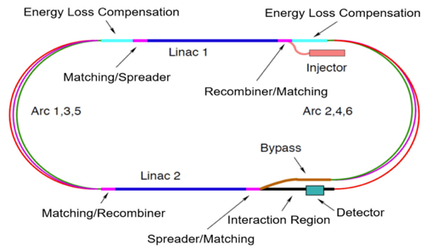
LHeC/FCC-eh: High energy & high luminosity electron-proton collisions
From HERA to LHeC:
3 order in magnitude in luminosity
1 order in magnitude in energy
→ LHeC a 1 GW beam power facility
With the planned R&D on ERLs, we will prepare the path for a 1 GW electron machine with only 100 MW power needed.
A Mutli-turn ERL (3+3 passes), 50 GeV, RF Frequency: 801.52 MHz, 20 mA beam current (6x20 = 120 mA load in the cavities)

Slide 20
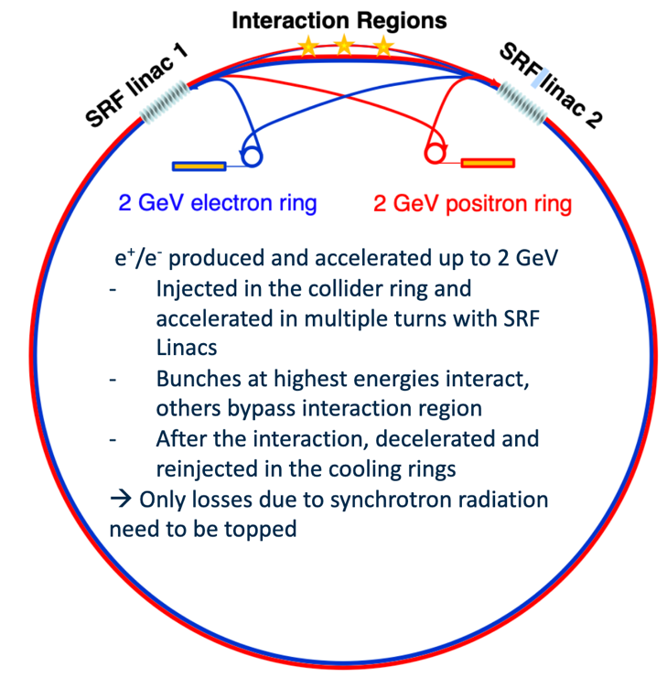
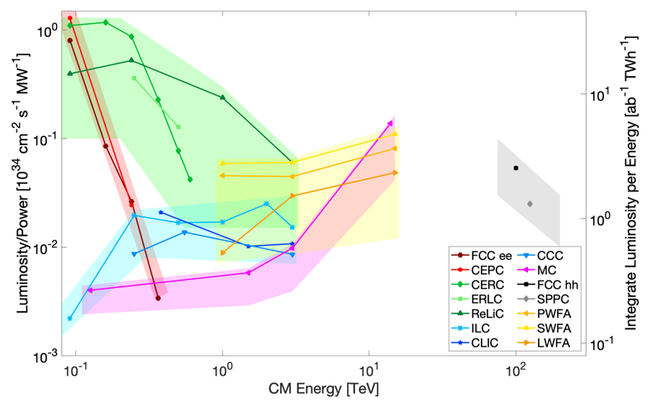
Circular Energy Recovery Collider (CERC): Re-Imagining FCC-ee as an ERL
Two 11 to 90 GeV SRF linacs in 4 pass configuration
100 MW power consumption (1/3rd of circular collider consumption)
Synchrotron radiation (SR) power-loss fixed to 30 MW (1/3rdof FCC-ee)
Luminosity predictions exceeding FCC-ee substantially at all CoM
CoM Energy reach of 600GeV in 100km circumference tunnel
V. Litvinenko et al. Physics Letters B, 804 (2020) 135394
pre-print:https://arxiv.org/abs/1909.04437

Slide 21
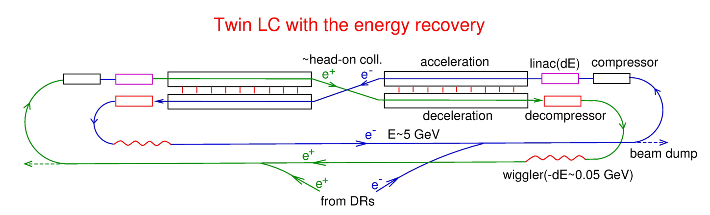
ERLC: A re-imagining of the ILC as an ERL
Compared to ILC, Luminosities at CoM 250GeV and 500GeV for equivalent wall plug powers of 120 MW and 150 MW respectively are found to be between one and two orders of magnitude greater, depending on the duty factor chosen.
However: The duty factor approach of 1/3 is a limitation for such machine for cryogenics efficiency. Without a vigorous R&D on 4K SRF operation (Q₀ at 10¹¹) and extraction of higher-order modes to high temperature, the build cost would be more than twice ILC.
V. Telnov/BINP, LCWS2021, https://indico.cern.ch/event/995633/contributions/4275159/
Preprint paper https://arxiv.org/pdf/2105.11015.pdf

Slide 22
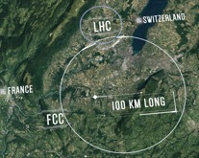


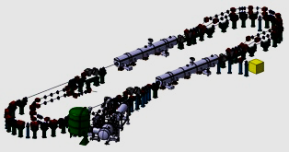
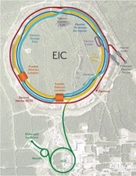

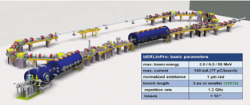


Summary:
Courtesy to Jorgen D’Hondt
Potential impact of ERL technology
enables the ultimate upgrade of the
LHC/FCC programs
2070’ies
ERL FCC-eh
demonstrate
multi-turn high-power ERL
2040-2050’ies
ERL for H/HH Factories
reuse ERL
2020’ies
iSAS
2030-2040’ies
2 ERL beams
2030’ies
high-power ERL for
e⁺e⁻ Higgs Factories
(Z/W/H/top/HH program)
PERLE
EIC
1 ERL beam
high-power ERL
e⁻ beam in collision
(ep/eA @ LHC program)
bERLinPro
increases the performance of the next major colliders
high-power ERL
demonstrated
ERL application
electron cooling

Slide 23
Thank you for your attention!

