Slide 1
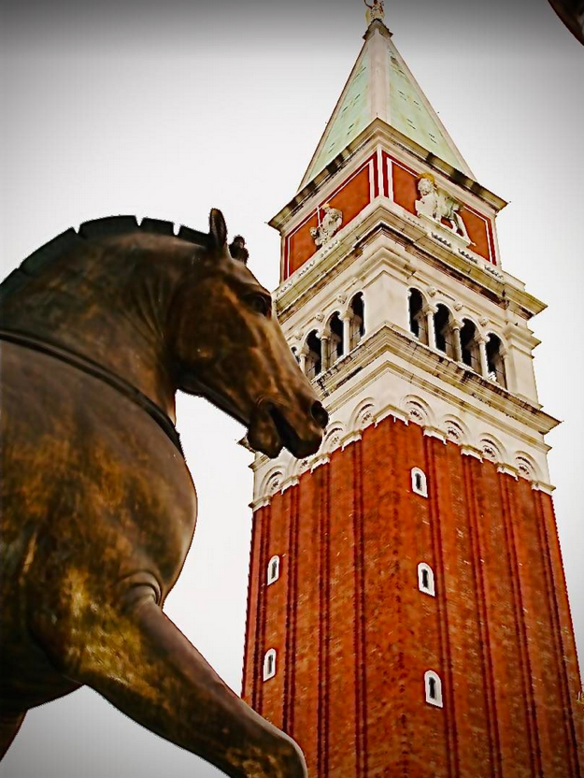
A novel facility for ERL development and applications in multi-turn configuration and high-power regime
Venice, May 10th 2023
Walid KAABI on behalf of PERLE Collaboration

Slide 2
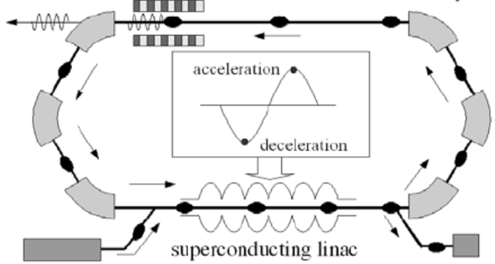
Introduction- ERL Concept
Acceleration:
RF power provided to cavities
The idea:
ERL Loop
(1’)
(1)
New beam injected in ERL loop
Acceleration to the top energy
(2’)…
(2)
acceleration
deceleration
ERL Loop
Kinetic energy of used beam recycled to re-excite cavities
Superconducting Linac
(4)
Beam used in IP
(3)
Injector
Beam dump
The benefits:
Reduce accelerator power consumption
Dumping the beam at injection power
Fresh beam in IP with the same characteristics
Deceleration:
180° RF Phase shift
More advantages:
Linac-like beam quality with extremely flexible time structure
High operating efficiency
Multi-pass configuration: High average current carrying capability (no more RF power limit) + High average beam power in a compact machine

Slide 3
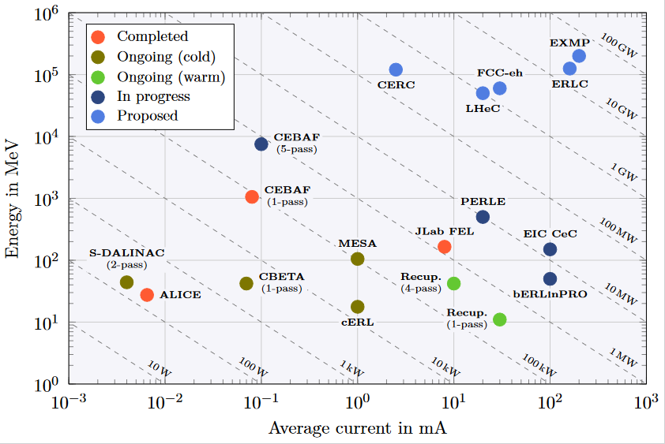
ERL - The global landscape
Funding Limited
Technology Limited

Slide 4
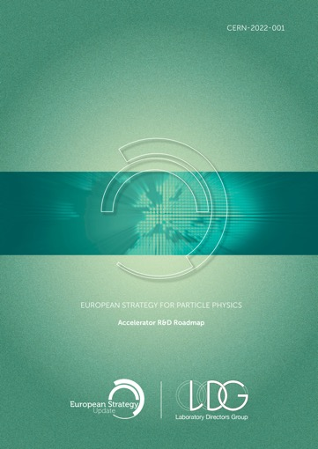
ERLs in the European Accelerator R&D Roadmap
ERL development has been recognized as one of the five main axis of accelerators R&D in support of the European Strategy for Particle Physics (ESPP):
High-field magnets
High-gradient RF structures and systems
High-gradient plasma and laser accelerators
Bright muon beams and muon colliders
Energy Recovery Linacs
The ERL Roadmap Panel, chaired by Max Klein and Andrew Hutton, has done a tremendous job with broad and active participation. PERLE & bERLinPro projects were recognized as one of the "essential pillars of the ERL development," with milestones to be achieved by the next ESPP in 2026.
ESPP R&D Accelerator Roadmap: https://arxiv.org/ftp/arxiv/papers/2201/2201.07895.pdf

Slide 5
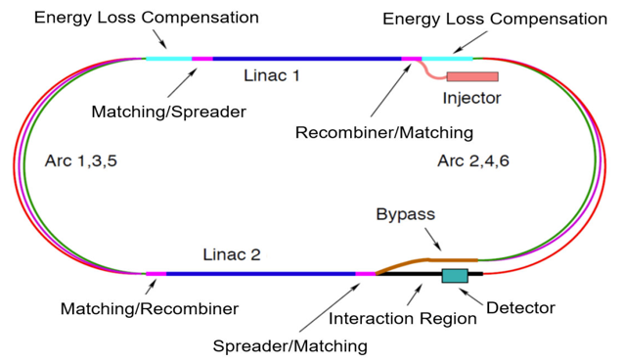
The short story of the PERLE Genesis
Future particle physics imposes strong challenges on accelerators and requires a variety of accelerator R&D programs not only to meet the foreseen performances, but also to lower their energetic consumption and enhance their efficiency.
→ Energy Recovery Linacs offer one of the main options for energy frontier colliders
To probe deep inelastic scattering at high energy and to study the Higgs boson, LHeC proposes a high luminosity collider using the HL-LHC protons and an intense electron beam.
For the electron beam, the ERL scenario has many advantages :
High luminosity, low interference for installation next to LHC, machine size, energy consumption
Concept also applied to the FCC-eh design
The ERL-ring collider concept of LHeC based on
synchronous operation of HL-LHC and 50 GeV electron beams
circumference of e- loop about 1/5 of that of LHC (5.3 km)
luminosity of 10³⁴ cm⁻².s⁻¹
Multi-turn ERL (3+3 passes), 50 GeV, RF frequency: 801 MHz,
20 mA beam current (6 x 20 = 120mA load in the cavities).

Slide 6
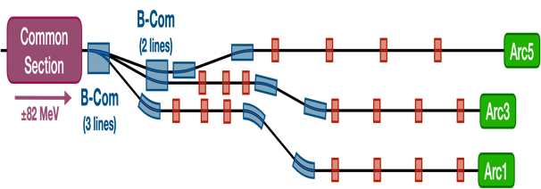
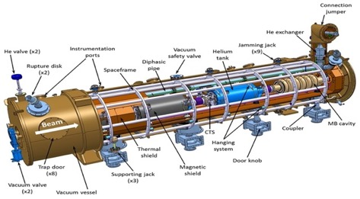
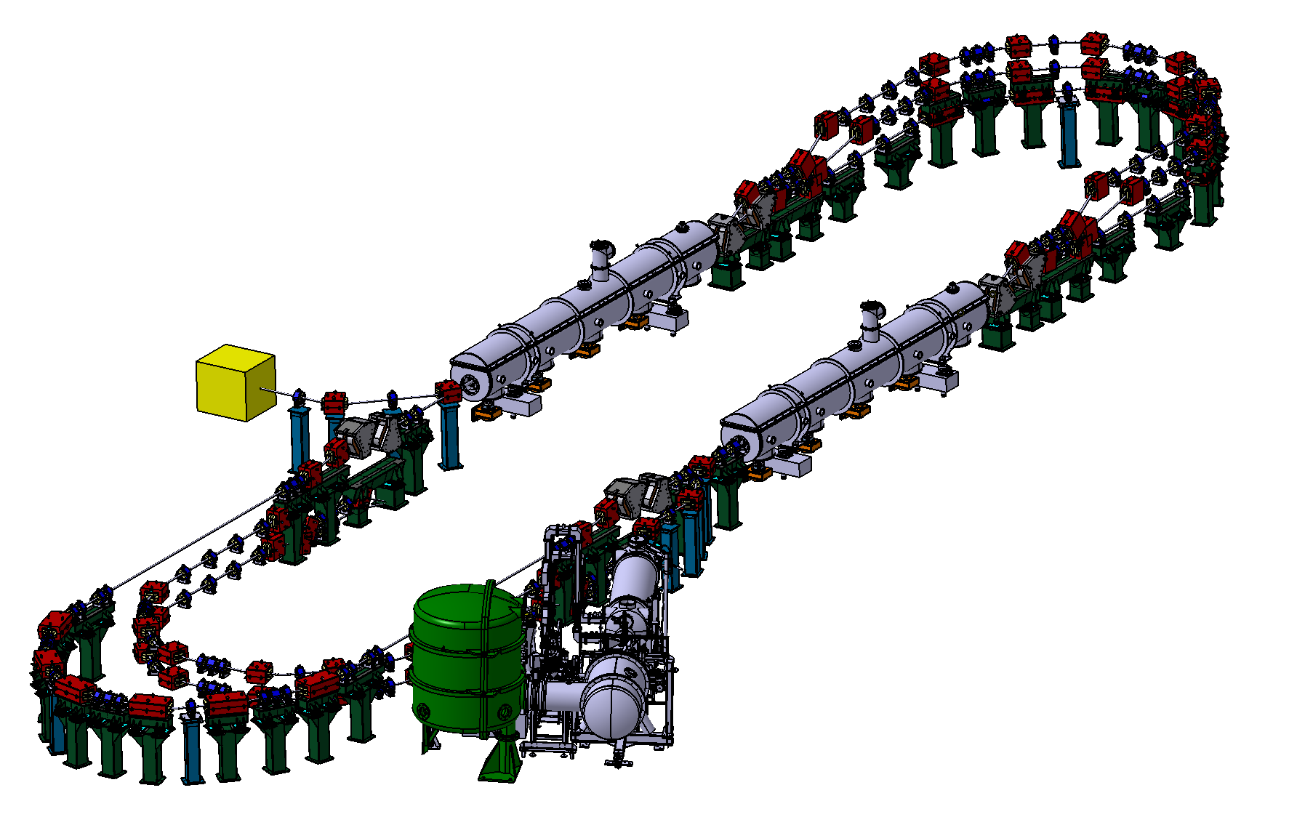
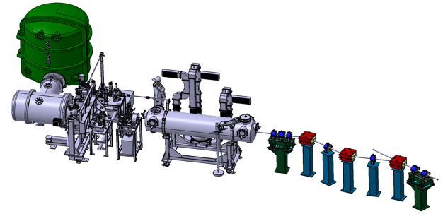
PERLE Configuration
PERLE: first multi-turn ERL, based on SRF technology, designed to operate at 10MW (20 mA, 500 MeV) power regime
→ A hub to explore a broad range of accelerator phenomena and to validate technical choices improving accelerators efficiency in an unexplored operational power regime on the pathway of the ERL technology development for future energy and intensity frontier machines.
Cryomodule with 4 five-Cell cavities
Total gradient 82 MeV
3 acc & 3 decc beams at different energies travelling in the CM.
Switchyard: vertical separation/recombination of beams at different energies
3 staked isochronous recirculation arcs for beams at different energies (Arcs 1, 3, 5).
Target Parameter | Unit | Value
Injection energy | MeV | 7
Electron beam energy | MeV | 500
Normalised Emittance γε_{x,y} | mm mrad | 6
Average beam current | mA | 20
Bunch charge | pC | 500
Bunch length | mm | 3
Bunch spacing | ns | 25
RF frequency | MHz | 801.58
Duty factor |  | CW
Beam dump
Interaction Points
HV tank
Photocathodes loading chamber (Sb-based photocathodes)
Buncher
350-500 kV
DC gun
Merger
3 staked (& inversed) isochronous recirculation arcs for beams at different energies (Arcs 2, 4, 6)
Injection line delivering 500pC bunches at 7 MeV.
Light box
Green laser 40 MHz
Booster: 5 single-cell cavities (802MHz) individually powered

Slide 7
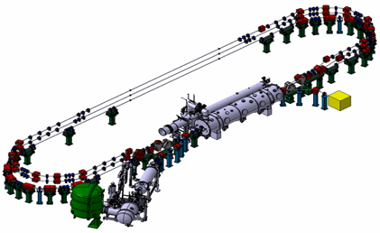
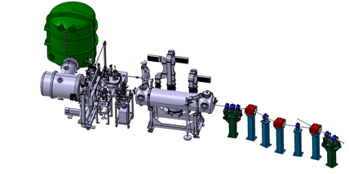
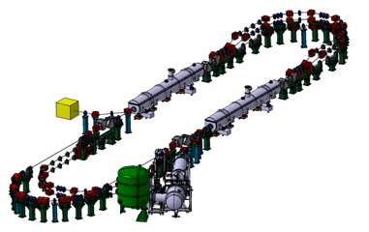
PERLE Timeline for TDR phase and beyond
Technical Design phase (TDR)
Prepare to Build phase (P2B)
Installation phases
Phase 1: Installation of the injection line
Phase 2: PERLE 250 MeV version
Phase 3: PERLE 500 MeV version
2020
2021
2022
2023
2024
2025
2026
2027
2028
2029
2030
2031

Slide 8
PERLE Lattice optimization
Lattices and optics for the 500 MeV and 250MeV PERLE versions were studied and optimised:
A full 1st order calculation were finished and a complete 250 and 500 MeV lattice is now available.
The stability of the lattice was crosscheck with different codes (OPTIM6, MADX & BMAD).
First specifications of quadrupoles and dipoles in switchyards & arc sections are obtained.
→ Further studies are ongoing/to be done: momentum acceptance, correction of nonlinear aberrations with multipoles, longitudinal match…
→ In addition to beam dynamics studies: Start to end simulations with CSR and microbunching, Multiparticle tracking, BBU, Impedance analysis and Wakefield effect mitigation …

Slide 9
Lattice optimization of the 500 MeV version of PERLE
40
Arc 1
1
30
1
89 MeV
171 MeV
Arc 2
BETA_X&Y[m]
DISP_X&Y[m]
DISP_X&Y[m]
BETA_X&Y[m]
S = 56 × λ_{RF}
S = 57 × λ_{RF}
0
-1
0
-1
0
20.94
0
21.32
40
Arc 3
1
30
Arc 4
1
254 MeV
336 MeV
BETA_X&Y[m]
DISP_X&Y[m]
BETA_X&Y[m]
DISP_X&Y[m]
S = 56 × λ_{RF}
S = 57 × λ_{RF}
0
0
-1
0
-1
20.94
0
21.32
40
418 MeV
Arc 5
1
30
Arc 6
1
500 MeV
BETA_X&Y[m]
DISP_X&Y[m]
S = 56 × λ_{RF}
BETA_X&Y[m]
DISP_X&Y[m]
S = 60½ × λ_{RF}
0
0
20.94
-1
0
-1
IR
0
IR
22.63
BETA_X
BETA_Y
DISP_X
DISP_Y
BETA_X
BETA_Y
DISP_X
DISP_Y
S.A. Bogacz et al. International Workshop on Deep-Inelastic Scattering and Related Subjects- Stony Brook University, New York, USA (2021), doi:10.21468/SciPostPhysProc.

Slide 10
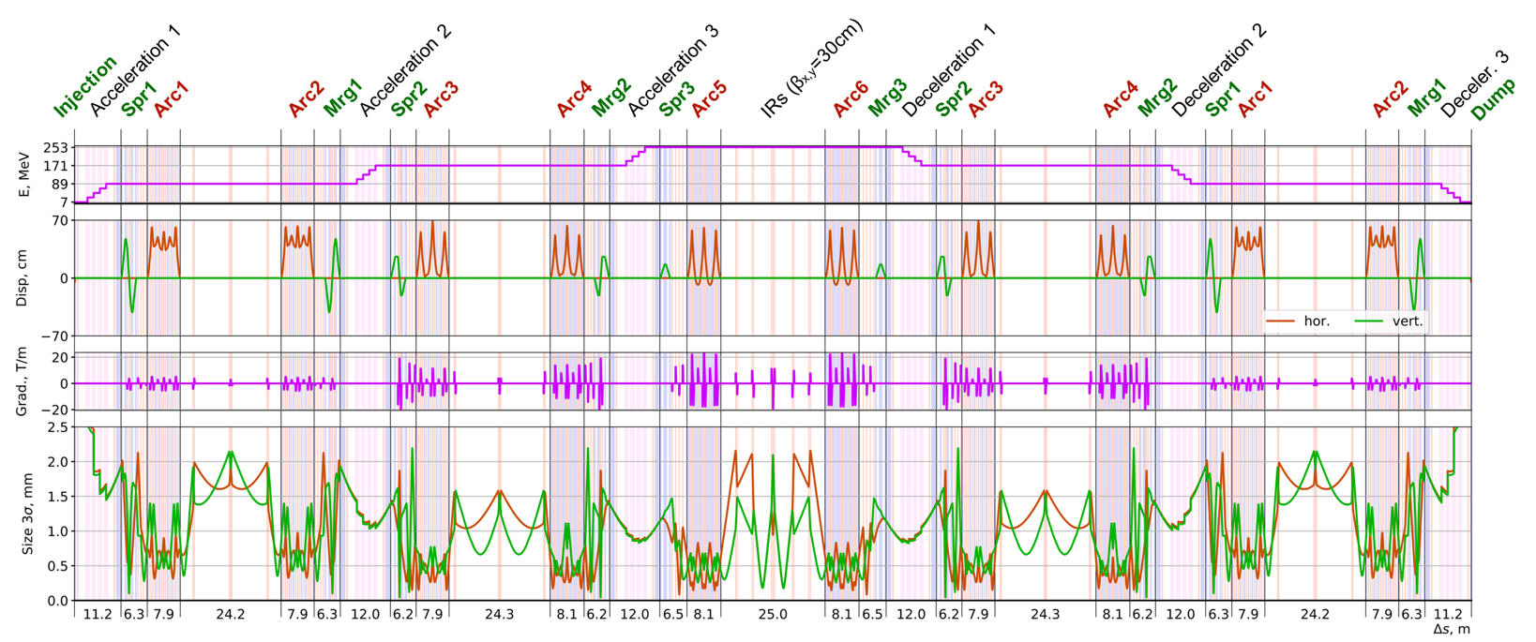
Lattice optimization of the 250 MeV version of PERLE
Transverse beam size (3$σ radius)<2,2 mm$($after the 2nd RF cavity),\text{Dispersion}\text{ < 70 }\text{cm}$ and Low beta function @ the 2 IRs
Alexis Fomin et al. “Lattice design of 250 MeV version of PERLE”- IPAC’23- TUPL171

Slide 11
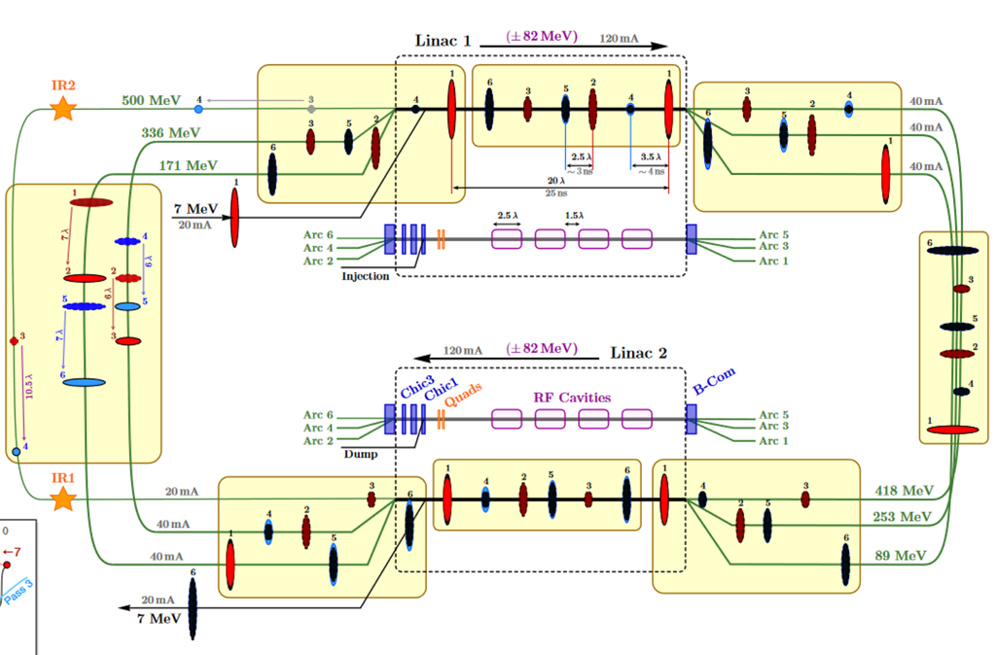
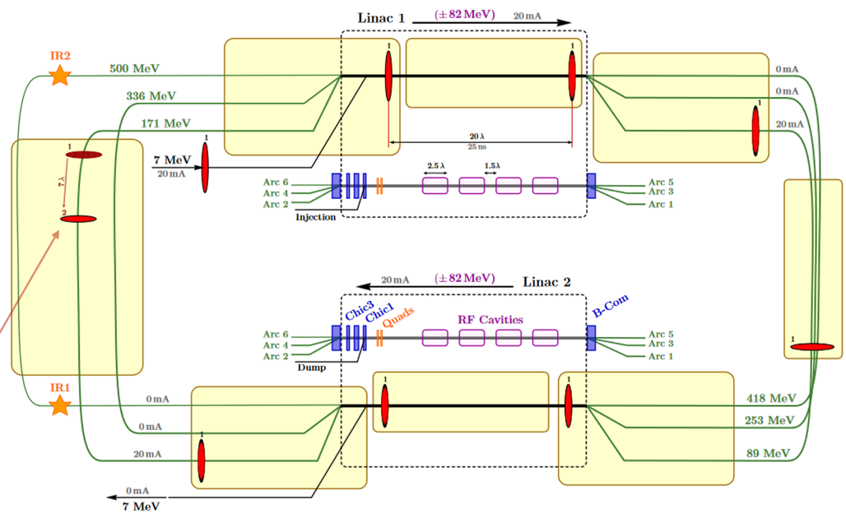
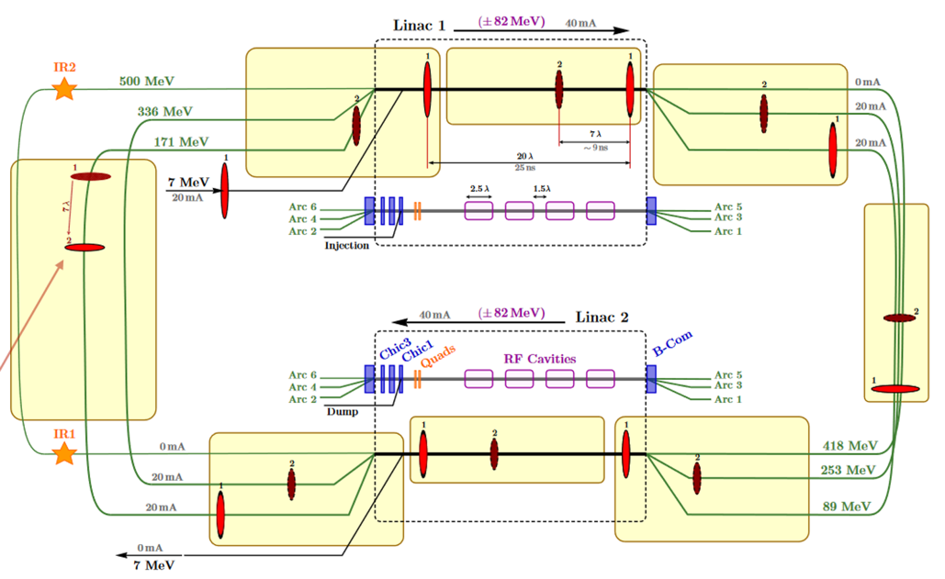
Bunch Filling Pattern studies
Pass 1
Pass 1-2
In the injection line:
500 pC e- bunchs generated at f_{inj}= 40 MHz
time spacing between bunches: 25 ns
average current: 20 mA
Bunches accelerated to 7 MeV in the injector then injected into the ERL loop
ERL Loop:
Cavity frequency: f_{RF}= 801,58 MHz (λ_{RF}= 34.7 cm)
f_{RF}/f_{inj =} 20
Length spacing between bunches: 20 λ_{RF}
During the 1st Pass:
Linac 1 → Arc 1 → Linac 2 → Arc2
7 → 89 MeV 89 → 171 MeV
1st Pass length= 167 λ_{RF}
8 bunchs injected in the 1st pass.
The 9th bunch Injected is followed by the 1st accelerated bunch in pass 1 that start pass 2 (spaced by 7 λ_{RF}).
Pass 1-6

Slide 12
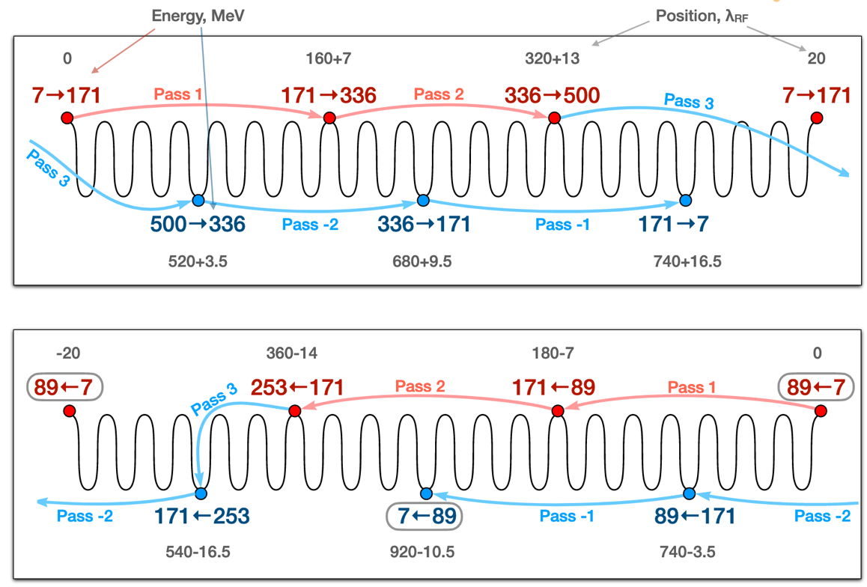
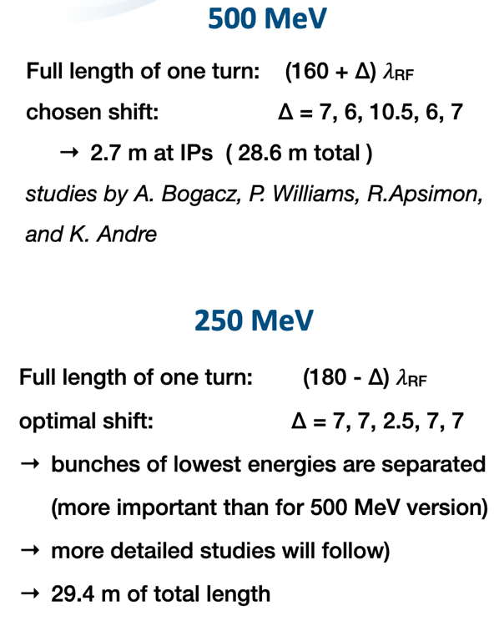
Bunch Filling Pattern 250 MeV Vs. 500 MeV version

Slide 13
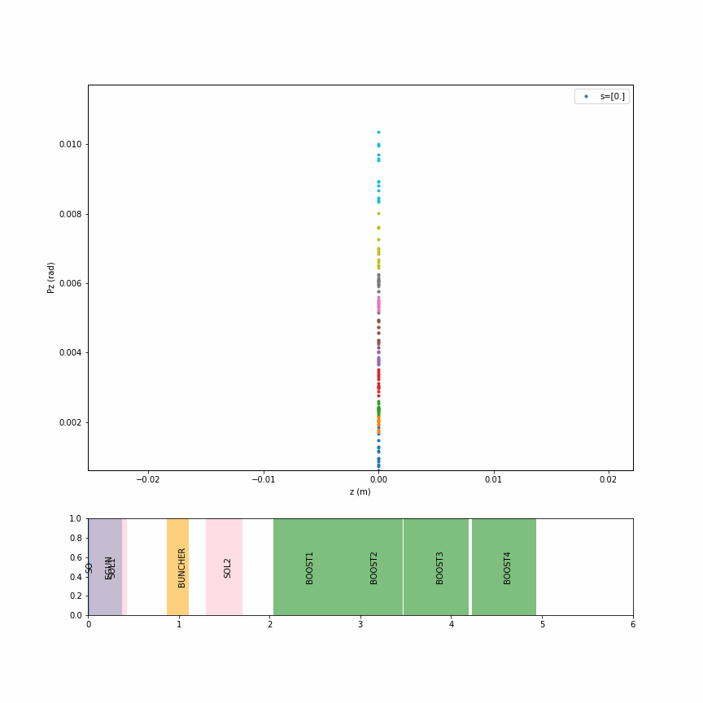
Injection line optimisation
A conceptual design of the PERLE injector was made within a collaboration between AsTeC-Daresbury, UoL and IJCLab. This included the DC gun cathode shape optimisation, a buncher cavity and the merger conceptual designs, besides a complete beam dynamic studies of space charge effects, phase space and bunch distributions, and emittance. Further studies and design optimisation of the injector are currently undertaken.
HV tank
Photocathodes loading chamber (Sb-based photocathodes)
Buncher
350 kV
DC gun
Merger
Light box
Green laser 40 MHz
Booster: 5 single-cell cavities (802MHz) individually powered
Solenoids focus beam in transverse plans
Buncher focus beam in longitudinal
M shape in z-pz axis at the end of injector : Might be a problem
B. Hounsell et al. “Conceptual design of the PERLE injector” LINAC’22- Liverpool, UK- THPOJO26
Transverse phase space (x-px)
Longitudinal phase space (z-pz)

Slide 14
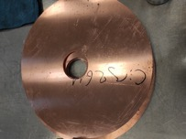
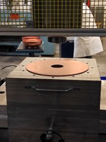
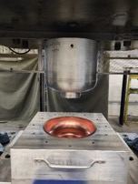
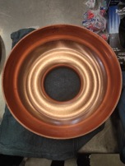
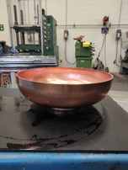
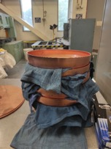
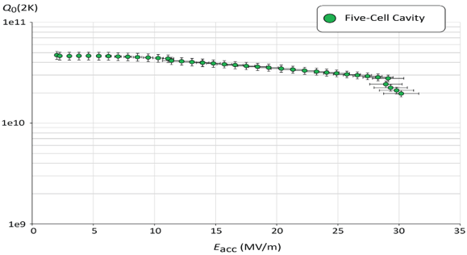
PERLE SRF cavity
PERLE Requirements | Impacts | Challenges | Possible Solutions
CW operation (RF) | High dynamic losses | The highest cavity Q₀ | Cavity post-treatment (Doping, infusion…)
High current operation | High HOMs excitation | Efficient HOMs extraction & damping | Act on cavity design: low frequency cavity choice (< 1GHz), larger cavity aperture, fewer cells for the a given gradient, optimisation of end-cell design.
Muti-bunches operation | Increase beam instabilities | The highest BBU threshold | Regular spacing of bunches: optimisation of the bunch filling pattern during Lattice design + BBU study after HOM optimisation (including collective effects).
A 5-Cell copper cavity is under fabrication @Jlab to allow end group design optimisation and to test several HOM couplers combinations to assess the best HOM damping scheme.
Q₀ (2k) = 3 e10 @ ~27 MV/m
Quench @ E_{acc} ~ 30 MV/m
PERLE requirements
First Nb 802 MHz 5-Cell cavity fabricated @ JLAB
F. Marhauser et al. “802 MHz ERL cavity design and development”- IPAC2018 (Vancouver, BC, Canada)- doi:10.18429/JACoW-IPAC2018-THPAL146

Slide 15
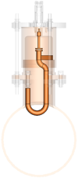
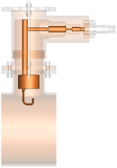
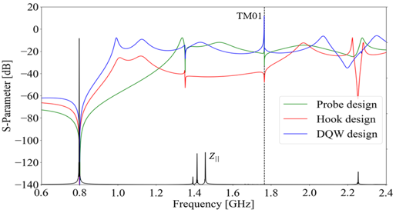
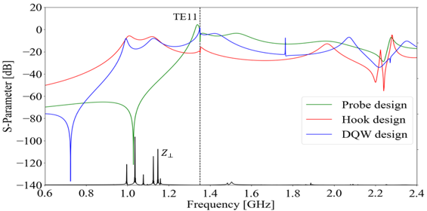
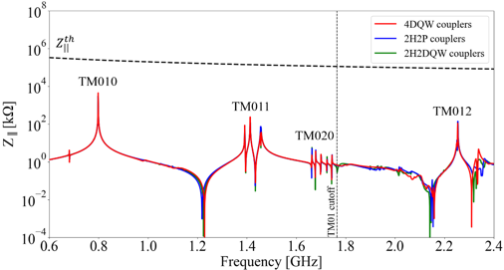
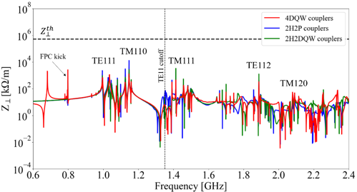
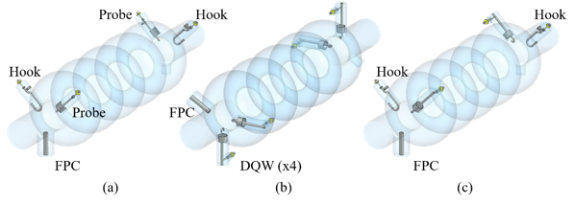
Status of HOM design studies:
HOM coupler optimization of 3 different designs
Monopole transmission
Dipole transmission
TM010
Optimized region
Probe Coupler
Hook Coupler
DQW Coupler
Optimized region
TM011
TM110
TM012
TE111
TM111
Couplers were geometrically optimized according to HOM spectrum ($Z_{||}$and $Z_{⊥}$) & S-parameters btw port 1 (beam pipe) & port 2 (coupler output) were studied.
The hook coupler provides higher damping of the first two dipole passbands (TE111 and TM110)
The DQW coupler exhibits a better monopole coupling for TM010 mode than the probe design.
Study of 2 damping schemes with 4 HOM couplers (Especially for dipole HOM extraction)
Longitudinal impedance spectra of the cavity
Transverse impedance spectra of the cavity
beam
beam
beam
→ Promising results of the 4 DQW scheme: It allows damping both monopole and dipole HOMs below the analytically-computed beam-stability limits

Slide 16
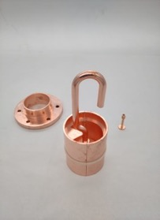
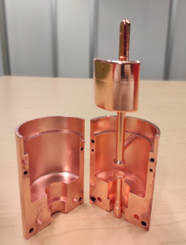
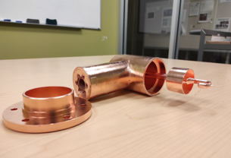
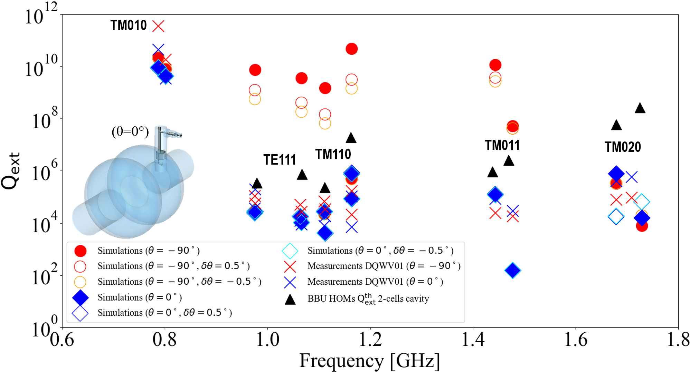
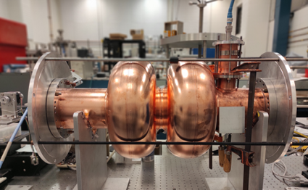
Status of HOM studies :
From RF design to performance measurements: Example of a fruitful collaborative effort between IJCLab, Jefferson Lab & CERN
Probe coupler
DQW coupler
Hook coupler
3D-printed prototype (Epoxy Accura 48) copper-coated @CERN
Measurements are made as a function of rotation angle of HOM coupler hook.
Good rejection of Fundamental Mode, Q_{ext} > 1E+09.
Measured Q_{ext} for HOMs are below BBU limit thresholds.
Good agreement between measured and simulated Q_{ext} → could be improved with more appropriate boundary conditions at beam pipe apertures.
Installation in a double-cell Cu cavity and test of performances (S12, $β_{1},β_{2},$Q_{L} and Q_{ext}) @JLab
C. Barbagallo et al. “First RF measurements of coaxial HOM coupler prototypes in a copper cavity for the PERLE project”- IPAC’23- MOPA025

Slide 17
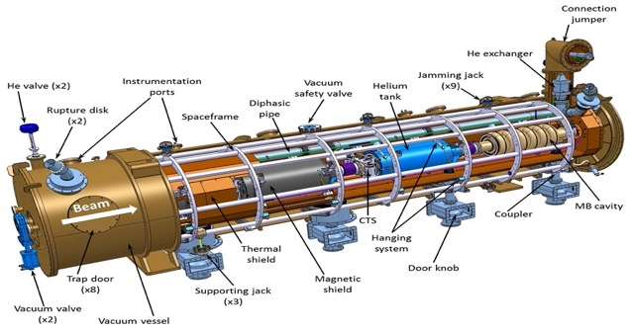
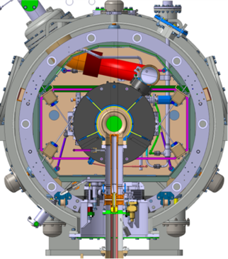
Cryomodule design:
ESS Cryomodule design was selected:
Intermediate supporting structure (spaceframe)
Cavity string hung by rods
Insertion of the cavity string by the extremity (rollers)
Trap doors for tuner access
Connexion to the valve box on the top of the vacuum vessel
Important space available inside
Design validated: series fab. & tests ongoing (Qty 30)
1st Cryomodule: Foreseen for 2027
Adapted from ESS design, it will be optimised for efficient high current ERL operation within the European Infra-Tech program iSAS*. It will host cavities equipped with HOM couplers and FPC optimised and developed within the same program.
2nd Cryomodule: Foreseen for 2030
May include some/all the technologies studied within iSAS program to improve the efficiency of Cryomodules: Fast Reactive Tuner (FRT) for microphonics mitigation, LLRF managed by AI and 4.2 K Cavities operating.
* More information on iSAS program: https://indico.ijclab.in2p3.fr/event/9521/

Slide 18
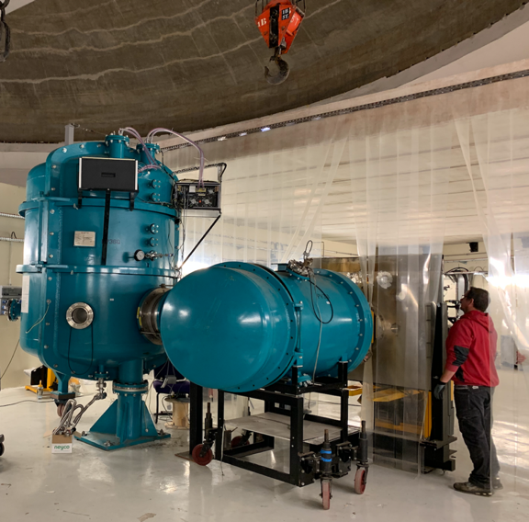
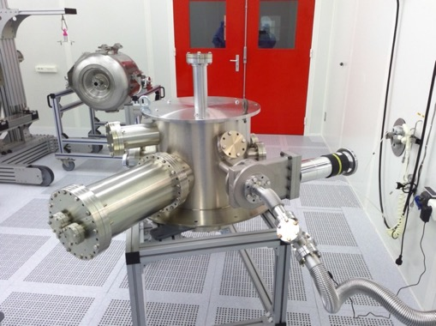
PERLE e- Source
Installation of Daresbury DC gun
Vacuum pumping of gun new chamber after ultrasonic cleaning (December 2022)
Installation of the former Alice DC Photogun (Daresbury) @ IJCLab-Orsay (January 2023)
New opportunity under discussion
Ongoing discussions with Research Instruments GmbH (RI) to acquire a state-of-the-art e- photogun:
the DC gun is fabricated, commissioned and approved for high current operation.
C. Quitmann et al. «Test of a DC- Photogun injector for The Lighthouse Facility” – Proceedings for IPAC’23- TUPA020

Slide 19
Conclusions
ERL machines open a new frontier for the physics of “the electromagnetic probe” (ep, eA, eN). PERLE is a key ERL project for HEP and Nuclear Physics communities
PERLE has been recognised (together with bERLinPro) an essential pillars of the ERL ESPP strategy. It will be the first ERL that combines high current and multi-passes (high luminosity/higher energy), designed to operate at 10 MW power regime.
PERLE is a very challenging machine : Though to be a hub to explore a broad range of accelerator phenomena and to validate technical choices improving accelerators efficiency in an unexplored operational power regime on the pathway of the ERL technology development for future energy and intensity frontier machines.
The International collaboration is formed and still opened to new comers.
Important boost in the last year in France and we are actively entered in the TDR and the P2B phases. The installation of the first brick of the machine (e- DC-gun) is ongoing.

Slide 20
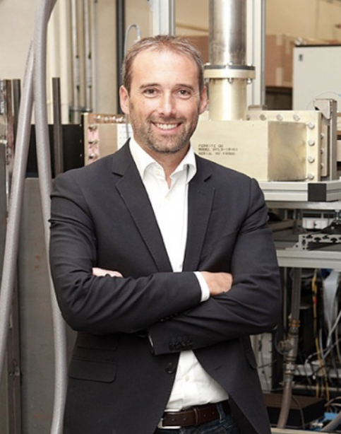
In the memory of Sébastien
Sébastien was an internationally recognized expert, who has worked throughout his career to lead R&D on superconducting accelerating systems. For more than twenty years, he put his skills and dynamism at the service of the discipline and assumed high responsibilities at IPNo, IJCLab and IN2P3-CNRS: project manager then manager of the SUPRATech technological platform, coordination of major work packages in large European programs (EURISOL, TIARA) or project manager of CNRS contribution to the European Spallation Source- ESS.
He was distinguished by the CNRS in 2015 with a crystal medal. With a real vision for the theme, he was one of the international experts involved in the European accelerator R&D strategy for the future of particle physics.
Since 2020, he has been Director of the Accelerator Physics pole and Associate Scientific Director of the IJCLab. Beyond his skills and his leadership, Sébastien is recognized for his great human qualities. His passing is a huge loss for the accelerator community, which pays him unanimous tribute.
Sébastien Bousson
1972-2022

Slide 21
Acknowledgments
To all the colleagues that provides me with materials and contribute to the efforts presented:
Racha Abukechek, Hadil Abualrob, Kevin Andre, Robert Apsimon, Carmelo Barbagallo, Maud Baylac, Alex Bogacz, Sylvain Brault, Patricia Duchesne, Alex Fomin, Alexandre Gallas, Coline Guyot, Benjamin Hounsell, Gregory Iaquaniello, Max Klein, Etienne Labussiere, Rodolphe Marie, Julien Michaud, Boris Militsyn, Guillaume Olry, Gilles Olivier, Luc Perrot, Denis Reynet, Raphael Roux, Achille Stocchi, Peter Williams and Haipeng Wang.
PERLE related IPAC’23 contributions
Rasha Abukeshek et al. “Magnetic design of the commutational magnet and quadrupoles for PERLE accelerator”- MOPA023
Carmello Barbagallo et al. “First RF measurements of coaxial HOM coupler prototypes in a copper cavity for the PERLE project”- MOPA025
Alexis Fomin et al. “Lattice design of 250 MeV version of PERLE”- TUPL171
Coline Guyot et al. “Standing wave RF cavities modeling for multi-pass Energy Recovery Linac traking purpose”- TUPL170
Thank you for your attention!

